Slide 1
Electronic Data Capture: Introducing Medidata Rave
Karen Patterson, M.P.H.
SCHARP
Fred Hutchinson Cancer Research Center

Slide 2
Presentation Overview
What is Medidata Rave?
Why Electronic Data Capture (EDC)?
Why Medidata Rave as EDC of choice?
Features
Views & screenshots
Reports
What is Medidata Patient Cloud?
Questions

Slide 3
What is Medidata Rave?
Industry-leading electronic data capture (EDC) and management platform for the capture, management and reporting of clinical, operational and safety data.
Hosted on-line with a web-based interface

Slide 4
Why Electronic Data Capture (EDC)?
DATA ACCURACY
Real-time data & consistency checks
EFFICIENT DATA MANAGEMENT
Validated system
Legible entries
Automatic calculations
ORGANIZATION
User-friendly navigation
Search and filter options
Unified database
Greater visibility
21 CFR Part 11 (Electronic Records, Electronic Signatures)
CDISC/SDTM output
Submission-ready data
Data entry at sites
SDMC data entry process
Real-time data access
Unified database
Less time managing queries
DATA SECURITY
Data protected
Data backed-up
User and role-specific permissions
REGULATORY COMPLIANCE
Better data management quality performance
Data integrity
Electronic source data verification (monitors)
Reports
Notes:
First let’s step back and consider – why do we want EDC?
Real-time data access: sites can see their own data and their own queries at anytime (don’t have to wait for QC reports; no faxing; no managing paper CRFs)
Data consistency checks – options to add constraints on a form that prevent inaccurate or illogical values from being entered
Using a computerized system enables legible entries and automatic calculations for cleaner data
Search and filter options help user find exactly what they need easily
Unified database=data in one location (vs. separate datastreams; coding capabilities within the database)

Slide 5
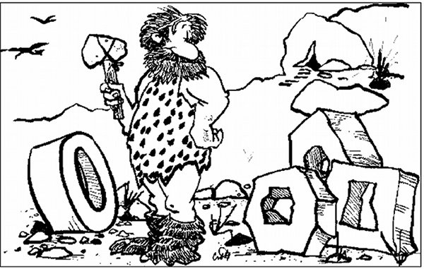
EDC Workflow

Slide 6
Why Medidata Rave?
SCHARP has selected Medidata Solutions as our partner for EDC (Rave)
Globally recogized EDC leader
In business since 1999
Supports over 400 clients, 9,000 trials, and 200,000 sites
Proven track record with partner organizations (e.g., Gilead, Janssen, Johnson & Johnson)
Notes:
Why Medidata – the company as EDC provider

Slide 7
Medidata Rave Features
Unified platform
Global Library capabilities
eLearning module & help icons
Translation capabilities
Additional integrated modules
Notes:
Unified platform: for study design, electronic data capture, local lab data capture and reporting
Global library capabilities: (including data checks) that accelerate study build
eLearning module: enabling site investigator and staffs to complete Rave user training within the system
Translation capabilities: enabling application screens to be presented in any language

Slide 8
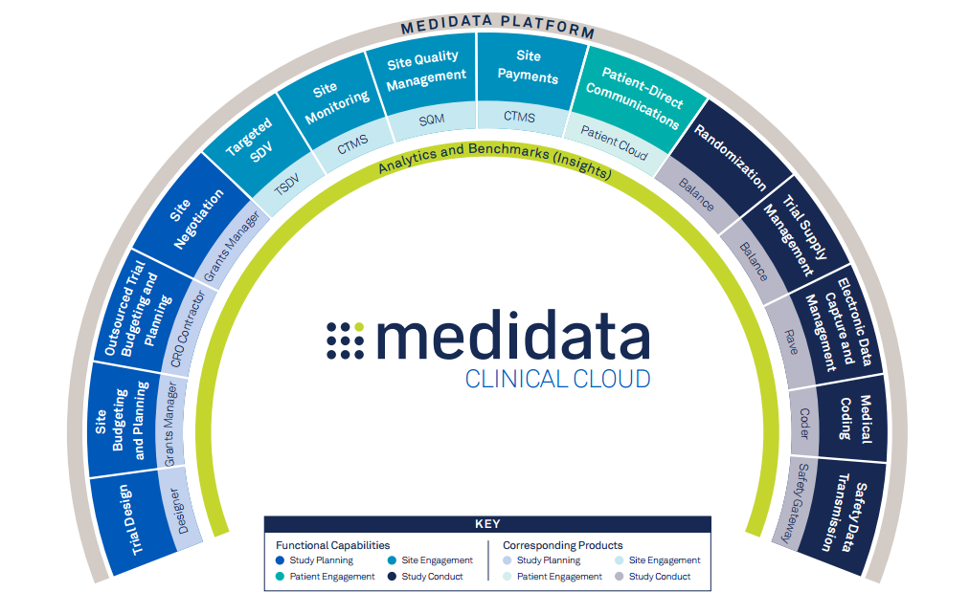
Medidata Integrated Platform
Notes:
Medidata – powerful EDC tool; diagram shows full breadth of tool’s potential; we are looking at using a fraction of it (specific modules) for the key areas highlighted

Slide 9
Medidata Rave What does it look like?
Screenshots of demonstration database
Site view
Monitor view
Data Manager (SDMC/SCHARP) view

Slide 10
Log-in Screen

Slide 11
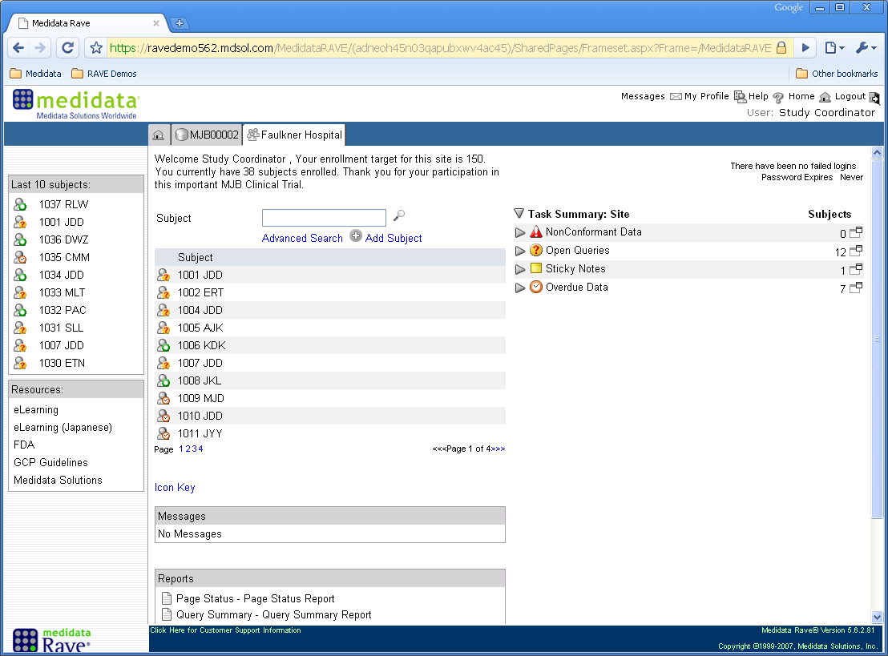
Site Home Screen
Navigation Tab

Slide 12
Site Home Screen
Participant ID (PTID) List

Slide 13
Site Home Screen
To-Do List

Slide 14
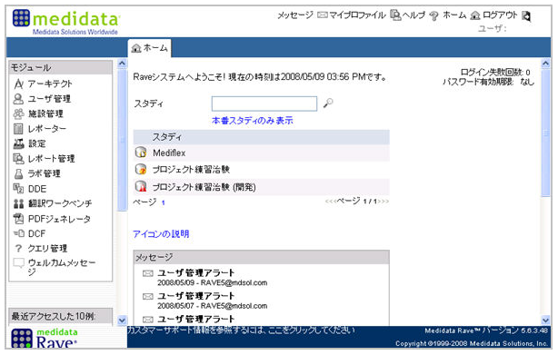
Site Home Screen

Slide 15
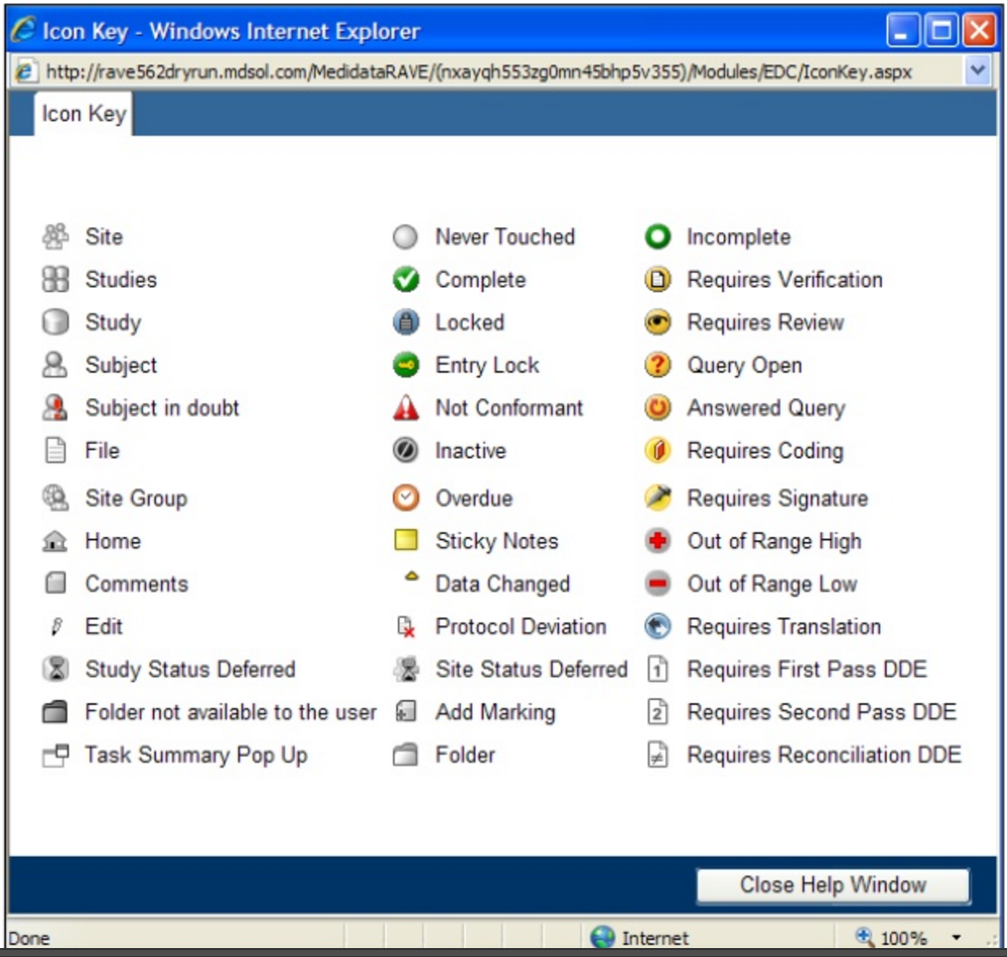
Medidata Icons

Slide 16
Site Home Screen
Resources and eLearning
Notes:
Software training
Required to be able to use
Modules or links

Slide 17
Site Home Screen
Assigned Reports
Notes:
Standard reports (the ones shown are canned reports and we can add to this list) made available to site by SCHARP that they can run on their own

Slide 18
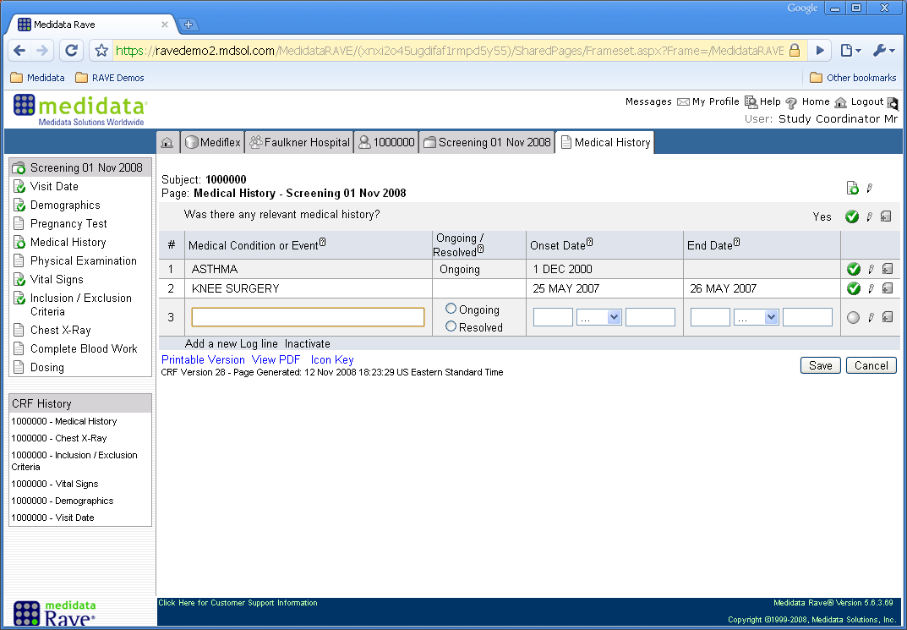
Participant Medical History

Slide 19
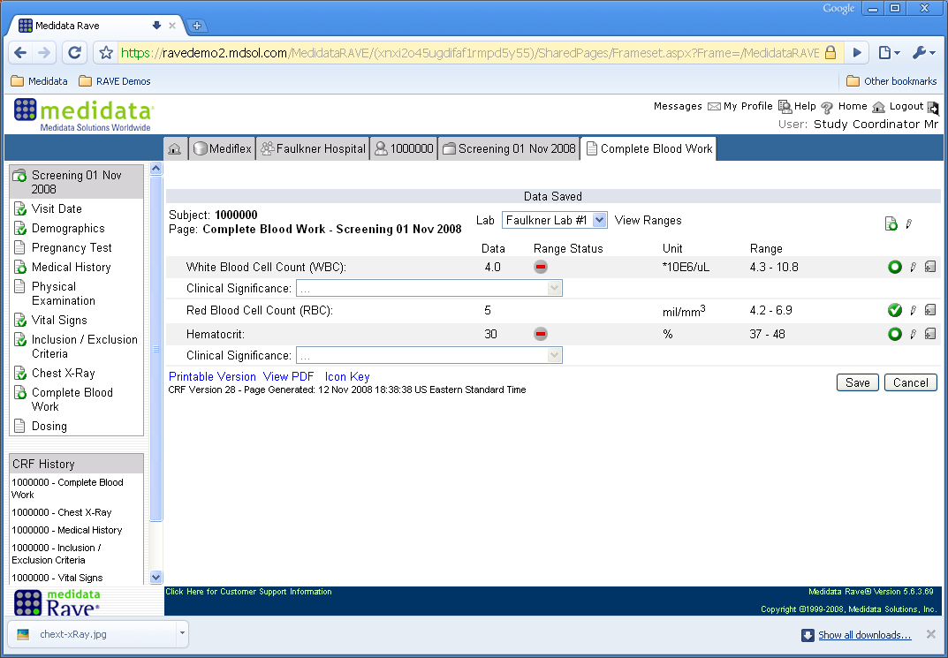
Site Entry of Lab Data
Notes:
Clinical significance optional
Lab form
Automatic calculations of severity grading – can populate as locked or editable field
Ranges are programmable and can be site-specific

Slide 20
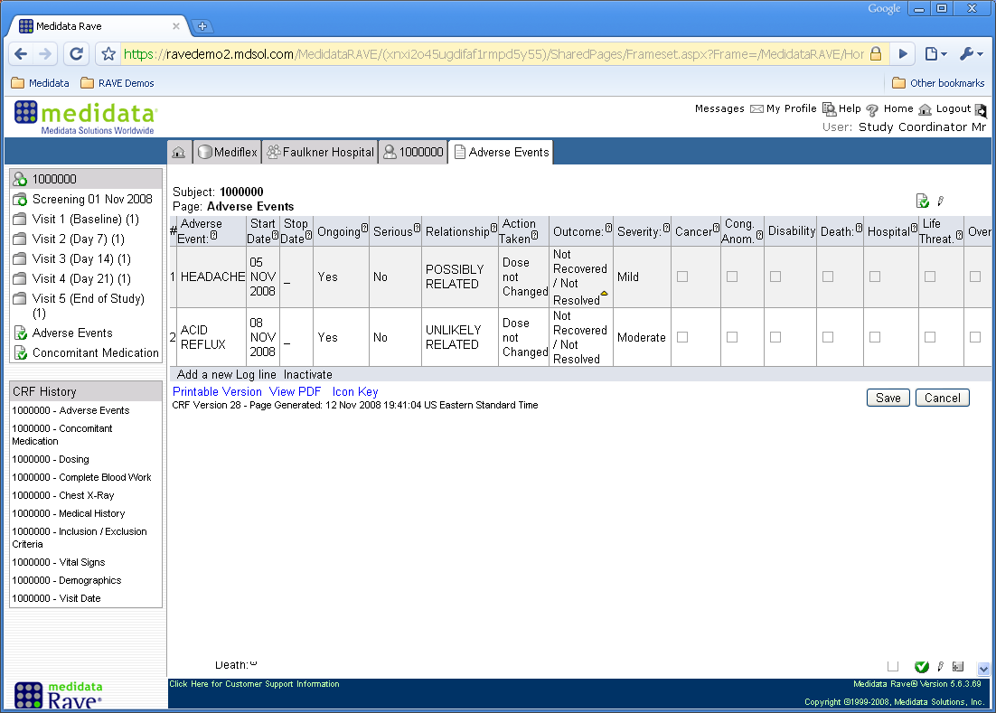
Adverse Events (AEs)
Notes:
Log form
Add multiple events by clicking on “add a new Log line” link
Visibility across visits – see at a snapshot what is still ongoing vs. resolved

Slide 21
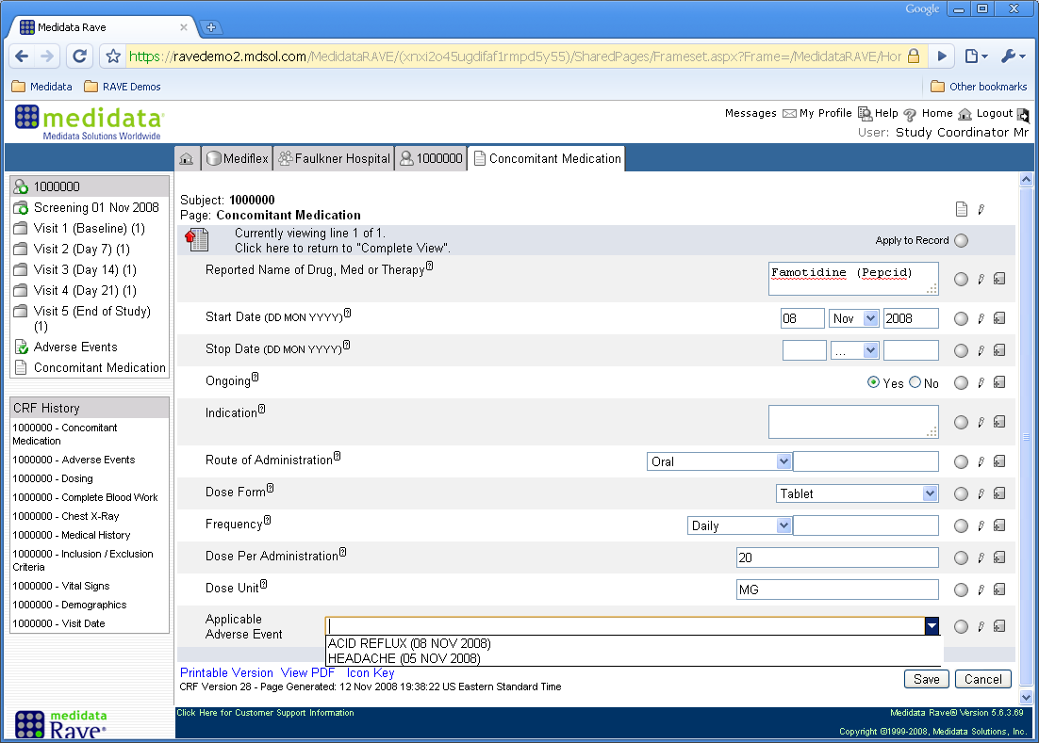
Concomitant Medications
Notes:
AE needs to be reported first; highlight that a given medication can be linked to an AE from the dropdown menu
Complete view will be like AE form – will show all con meds

Slide 22
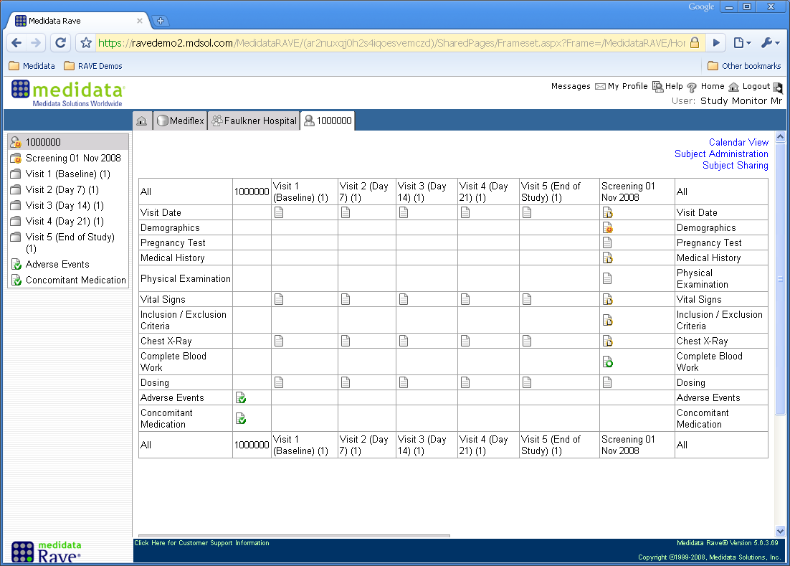
Grid View
Notes:
Example of visit matrix for one ppt; forms expected to be completed, and at which visits

Slide 23
Monitor View

Slide 24
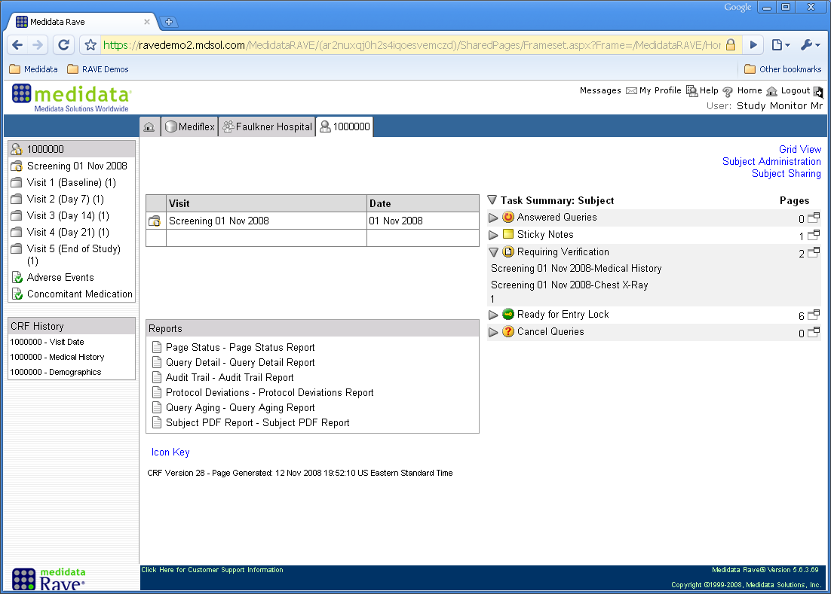
Monitor View
Notes:
Extra tasks and reports
Reports table will be tailored to match the study monitoring needs

Slide 25
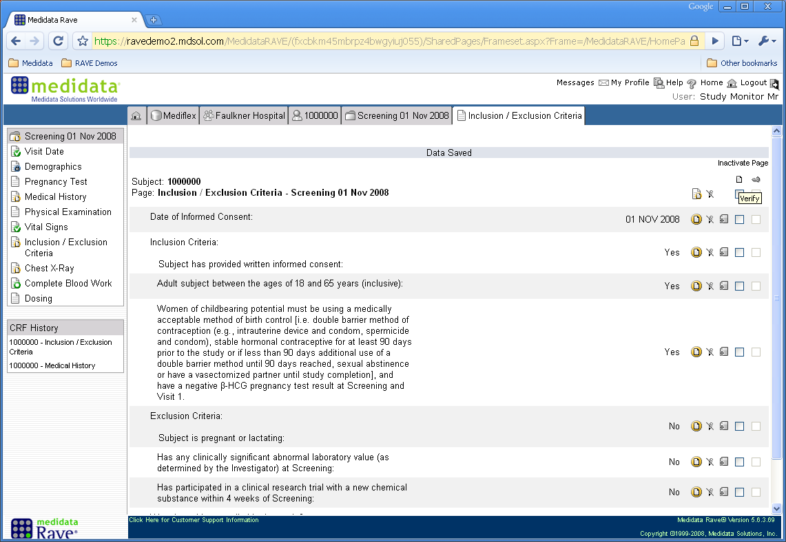
Monitor Source Data Verification
Source Data Verification (SDV) using the checkboxes
Notes:
Icon = requires verification
Note to Karen: monitor needs to complete all SDV boxes on a form for us to lock the form

Slide 26
SDMC/SCHARP
Data Manager View

Slide 27
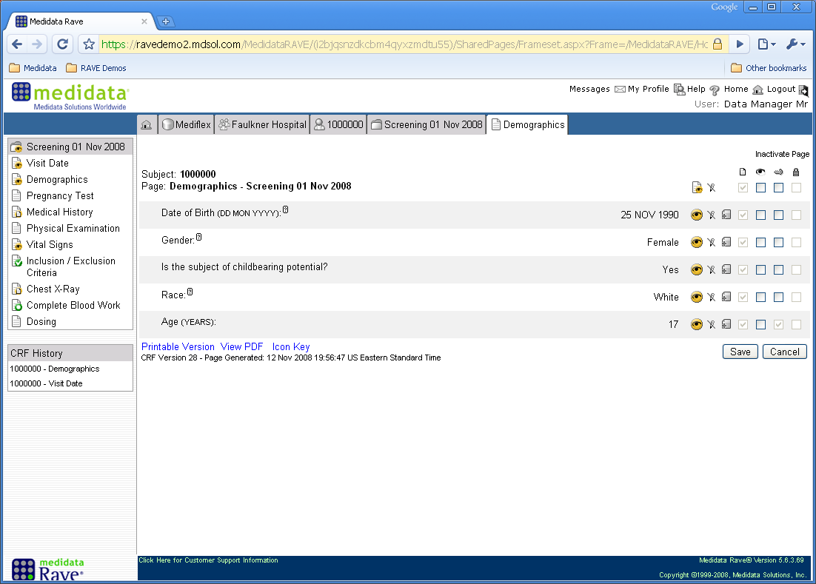
SCHARP Data Manager View
Notes:
First column is for the DM review
Second column is freeze for the SCHARP Data Manager (freeze means it’s ready to be locked and won’t change, but it doesn’t mean data can’t be unlocked and modified as needed
Third column is to lock

Slide 28
Data Entry Icons
Notes:
Non-conformant data: data not entered in expected format (e.g., entering “25” for month). Resolved when valid response (i.e., expected format) is entered and saved. Help icon next to a variable can be used to provide additional information/guidance as to what is expected.

Slide 29
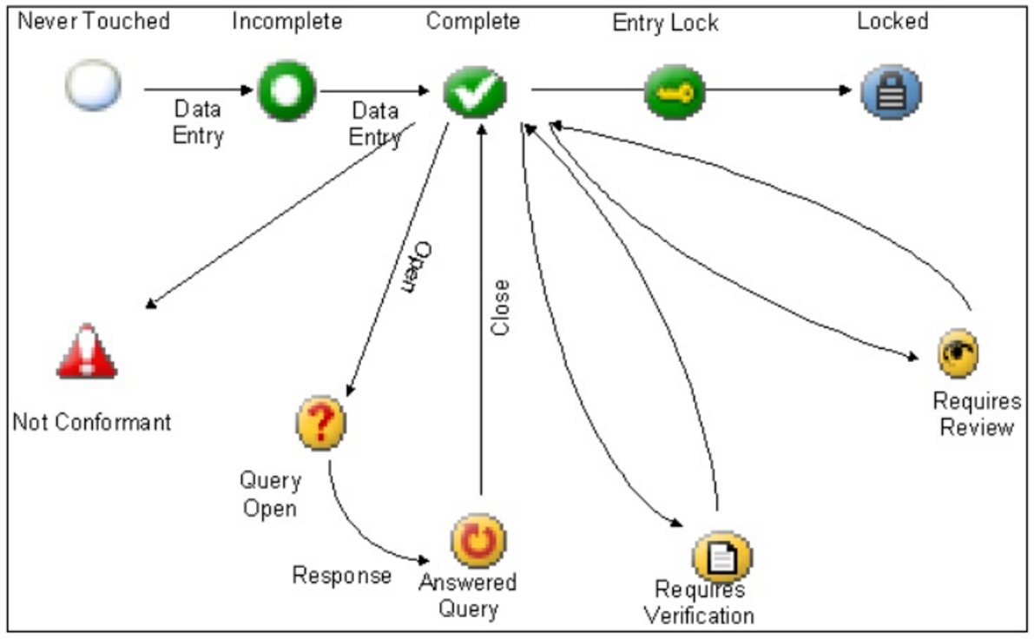
Data Workflow

Slide 30
Data Lock

Slide 31
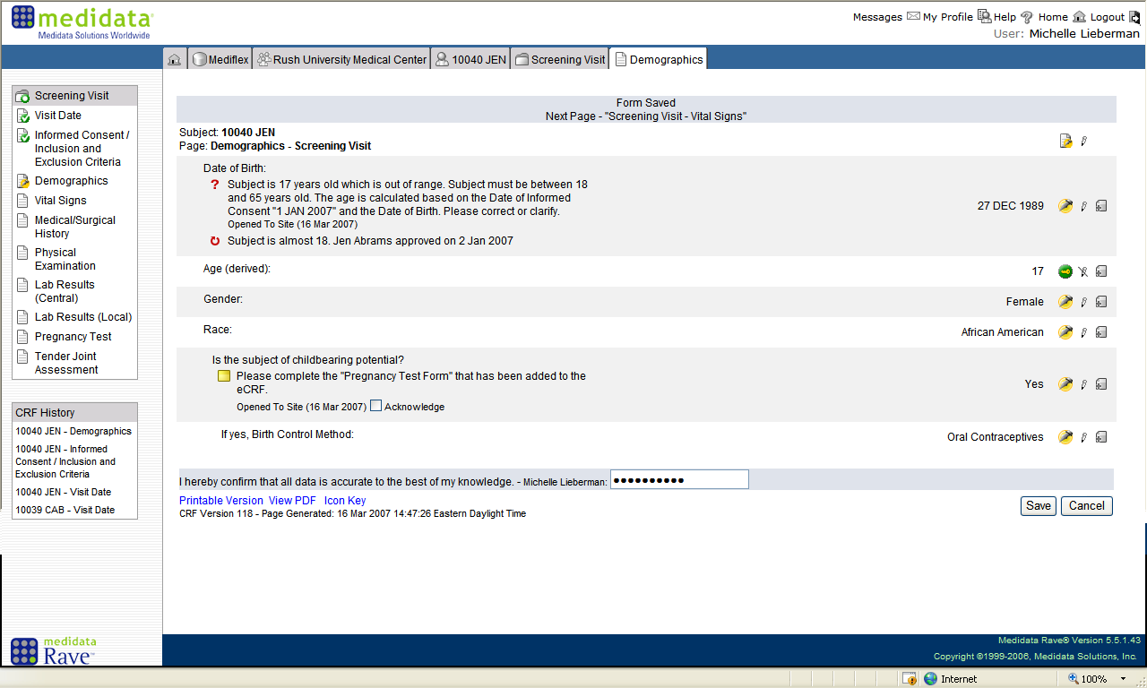
Site IoR View - eSignature
Notes:
This is done by the IoR; done by ppt; this is the last step needed to lock a given’s ppt’s data; all ppts need this sign off to lock the entire database

Slide 32
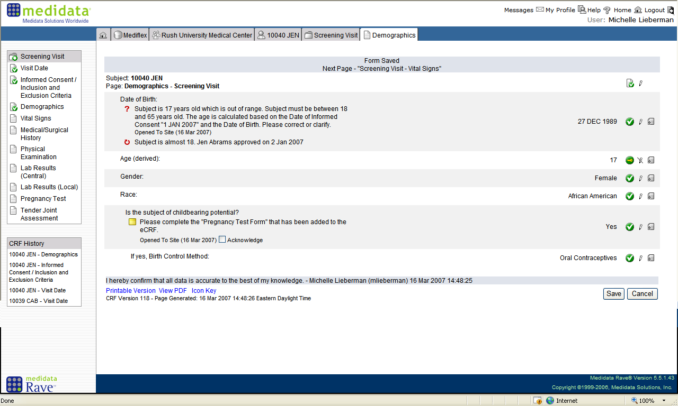
Site IoR View - eSignature

Slide 33
Medidata Reports
Standard
Ad hoc
Notes:
How are ad hoc reports defined? Do these need to be built in Medidata?

Slide 34
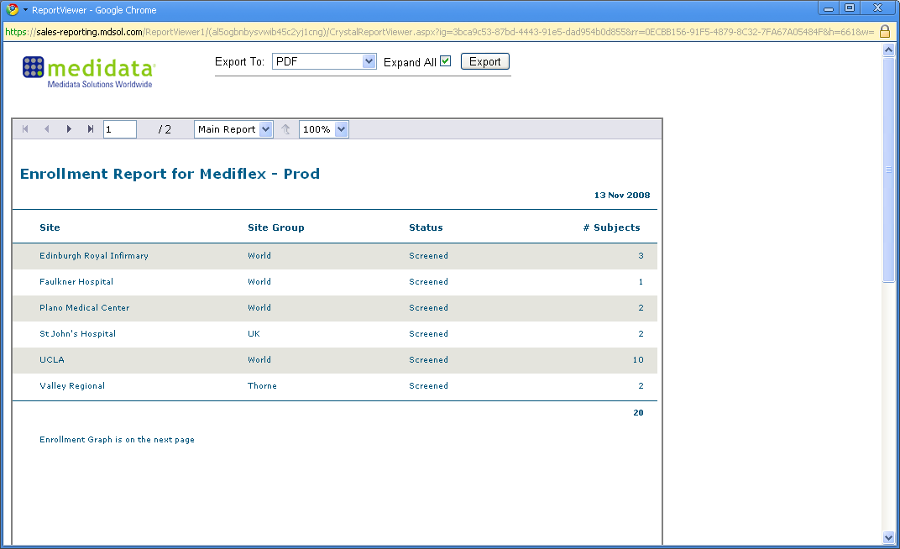
Standard Report - Enrollment

Slide 35
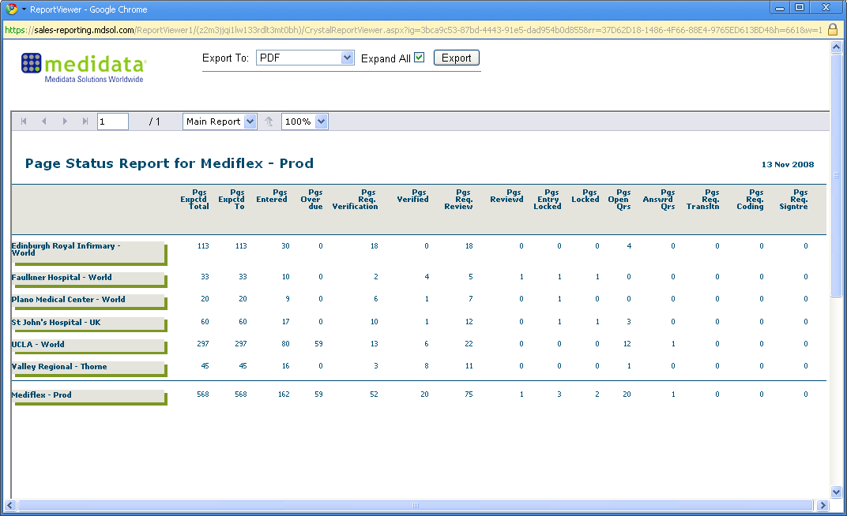
Standard Report – Page Status
Notes:
Sites will see only their own data; however, other sites’ data can be made visible (just not ppt-level data)

Slide 36
Medidata Patient Cloud

Slide 37
What is Medidata Patient Cloud?
Extension of Medidata Rave
Electronic Patient-reported Outcome (ePRO) software application (app)
Captures questionnaires and diary assessments
Operated on any app-ready iOS or Android device (e.g., smartphones, tablets)
Used in clinic or on participant’s own time
Off-line access available

Slide 38
Medidata Patient Cloud How does it work?
Configured same way as electronic data capture (EDC) – Medidata Rave
Same interface
Relevant forms pushed to participants by checking box
Download app
Sites register and train participants
Participants complete assessments
Notes:
delivers completed assessments directly to EDC (Medidata Rave); no separate databases to integrate or reconcile; visibility into data/issues; potential for reporting
Flexibility – ppts can use mobile device of their choice; questionnaires can be completed in and/or out of clinic; can address recall bias by capturing data more in real-time

Slide 39
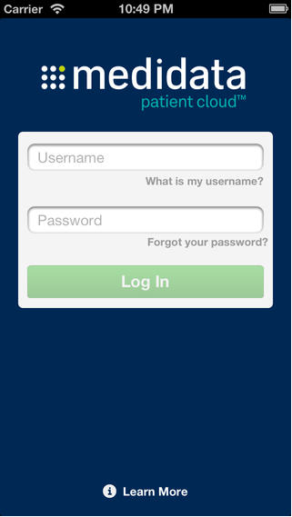
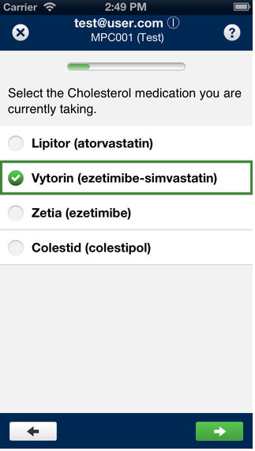
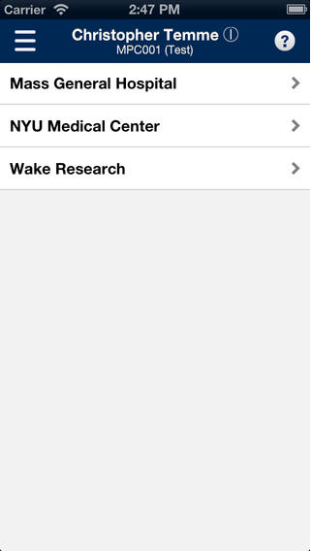
Medidata Patient Cloud
Notes:
First log-in screen seen by us and sites
Second view is ppt view
Third view is the monitor/SDMC view
Site would only see their own site’s data

Slide 40
Summary – Medidata
Robust
Flexible features
Easy to use
Data integration
Data security
Data accuracy
Regulatory compliance
Efficient data management
Notes:
Industry-leading electronic data capture (EDC) and management platform for the capture, management and reporting of clinical, operational and safety data. Rave’s robust and flexible set of features, ease-of-use at sites and advanced data import/export integration tools effectively support any trial design, fast study starts and quick access to meaningful data.

Slide 41
Summary – Medidata
More efficient data cleaning
Faster closeout
Less data queries
Analysis of high quality data
Less data streams
Faster data availability
Cleaner data

Slide 42
Questions?

