Slide 1

Overview of Follow-up:
Visit Types, Visit Scheduling, and CRFs

Slide 2
Follow-up Visits
Once enrolled, there are 8 required follow-up visits:
Visit 3 (Mid-period 1)
Visit 4 (End Period 1)
Visit 5 (Initiate Period 2)
Visit 6 (Mid-period 2)
Visit 7 (End Period 2)
Visit 8 (Initiate Period 3)
Visit 9 (Mid-period 3)
Visit 10 (End Period 3/Final Clinic/Early Termination)

Slide 3
Scheduling Follow-up Visits
Schedule fixed based on enrollment/randomization date
  does not change based on actual visit completion date
Target day is ideal
If not target day, schedule as close to target day as possible
  Preferably within target window (+/- 2 days)
  Otherwise, within allowable visit window
Allowable visit windows continuous

Slide 4
Visit Windows
Visit # | Visit | Visit Code | Target Day | Allowable Window Opens | Target Window Opens | Target Window Closes | Allowable Window Closes
1 | Screening | 1.0 | N/A | N/A | N/A | N/A | N/A
2 | Enrollment/ Initiate Period 1 | 2.0 | 0 | Day after Screening | N/A | N/A | 30 days after Screening informed consent date
3 | Mid-period 1 (Week 4) | 3.0 | 28 | 14 | 26 | 30 | 41
4 | End Period 1 (Week 8) | 4.0 | 56 | 42 | 54 | 58 | 60
5 | Initiate Period 2 (Week 9) | 5.0 | 63 | 61 | 61 | 65 | 76
6 | Mid-period 2 (Week 13) | 6.0 | 91 | 77 | 89 | 93 | 104
7 | End Period 2 (Week 17) | 7.0 | 119 | 105 | 117 | 121 | 123
8 | Initiate Period 3 (Week 18) | 8.0 | 126 | 124 | 124 | 128 | 139
9 | Mid-period 3 (Week 22) | 9.0 | 154 | 140 | 152 | 156 | 167
10 | End Period 3 (Week 26) | 10.0 | 182 | 168 | 180 | 184 | 195

Slide 5
Visit Codes
Why are they used?
  To indicate at which point in a ppt’s trial participation an event occurred
Helpful when reviewing reports and conducting study analyses
  Knowing that a ppt had a grade 2 AE on 23-OCT-13 doesn’t tell us much; knowing this is his/her Mid-period 2 visit does
Visit Code = Visit Number
  E.g., Visit Code 4.0 = Visit 4 (End-period 1)
Termination Visit does not have unique visit code
Notes:
Early termination: visit code depends on where ppt is in visit schedule at time of termination

Slide 6
Visit Calendar Tool
An Excel file that can be used to create the follow-up visit schedule/calendar for a ppt with actual dates
  Posted on MTN web site under “Study Implementation Materials”
Requires PTID and full Enrollment Date
For each required follow-up visit, the target date, target windows, and allowable windows are generated
Blank columns for site to write-in scheduled and actual visit dates
For easy reference, print and place in the ppt’s study notebook once ppt has enrolled

Slide 7
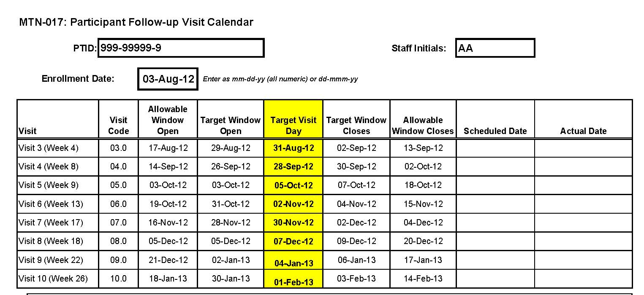
Visit Calendar Tool – Output

Slide 8
Missed Visits
A follow-up visit is missed once allowable window closes if s/he has not completed any part of visit
E.g., participant completes Visit 3 (Mid-period 1), then does not contact clinic again until Day 65
  Visit 4 (End Period 1) allowable window closed on Day 60, thus Visit 4 is missed

Slide 9
Missed Visits
Missed Visits are documented in the study database using the Missed Visit CRF
Do not complete or fax any other CRFs for the missed visit
  Protocol Deviation Log not completed/required
The Missed Visit form will let DataFax/SCHARP know not to expect any other forms for that participant with that visit code.

Slide 10
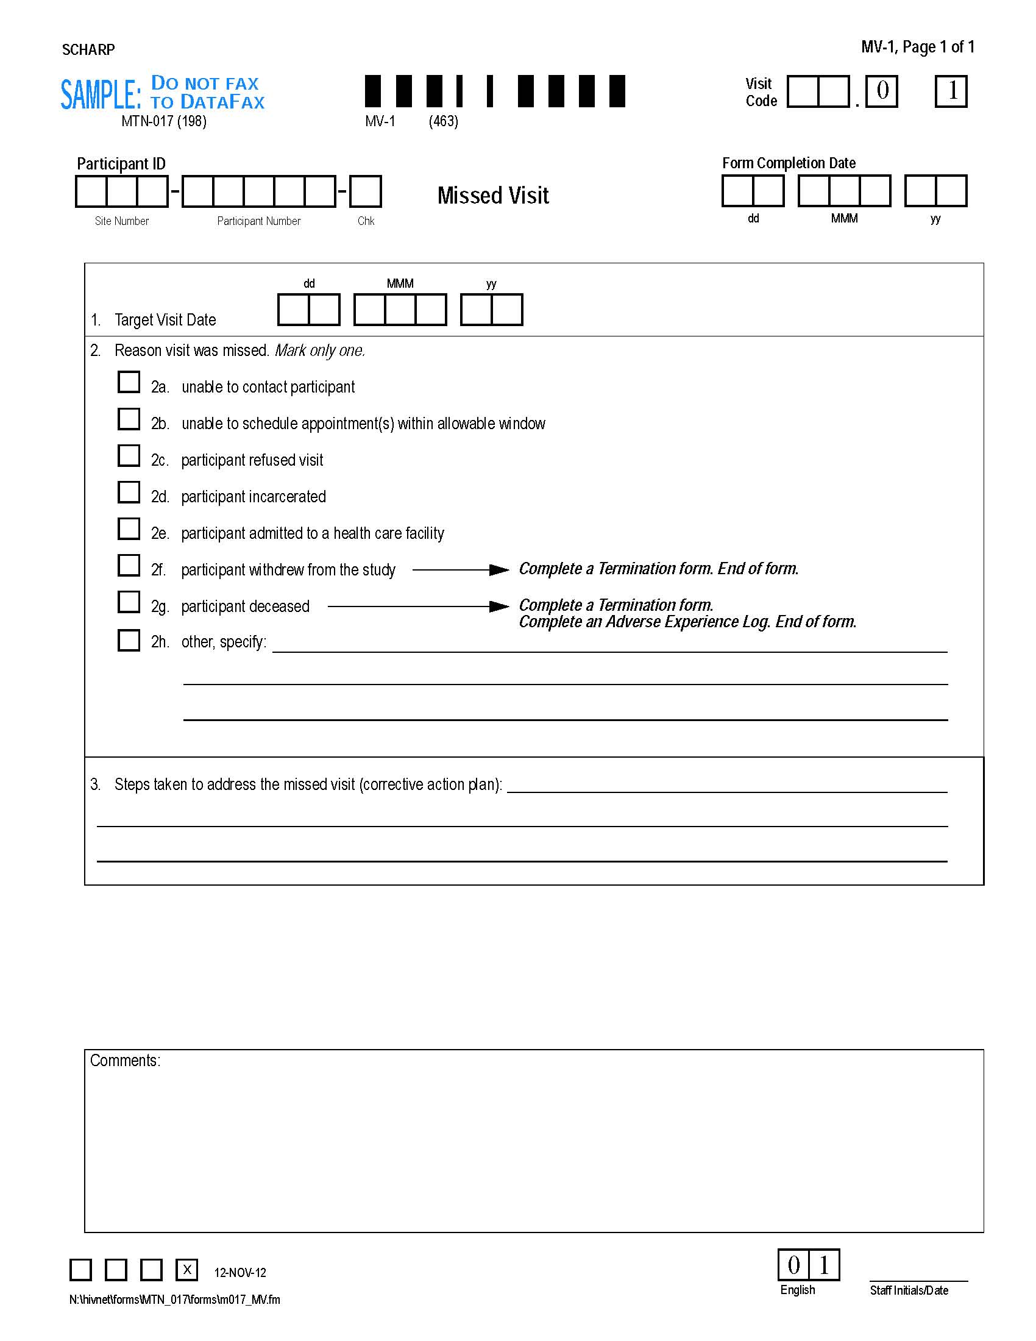
Missed Visit Form
Visit Code has pre-printed “.0” at end
Target date is per ppt calendar
Item 3 Corrective action plan
Notes:
Plan does not yet have to be executed in order to complete and submit the form

Slide 11
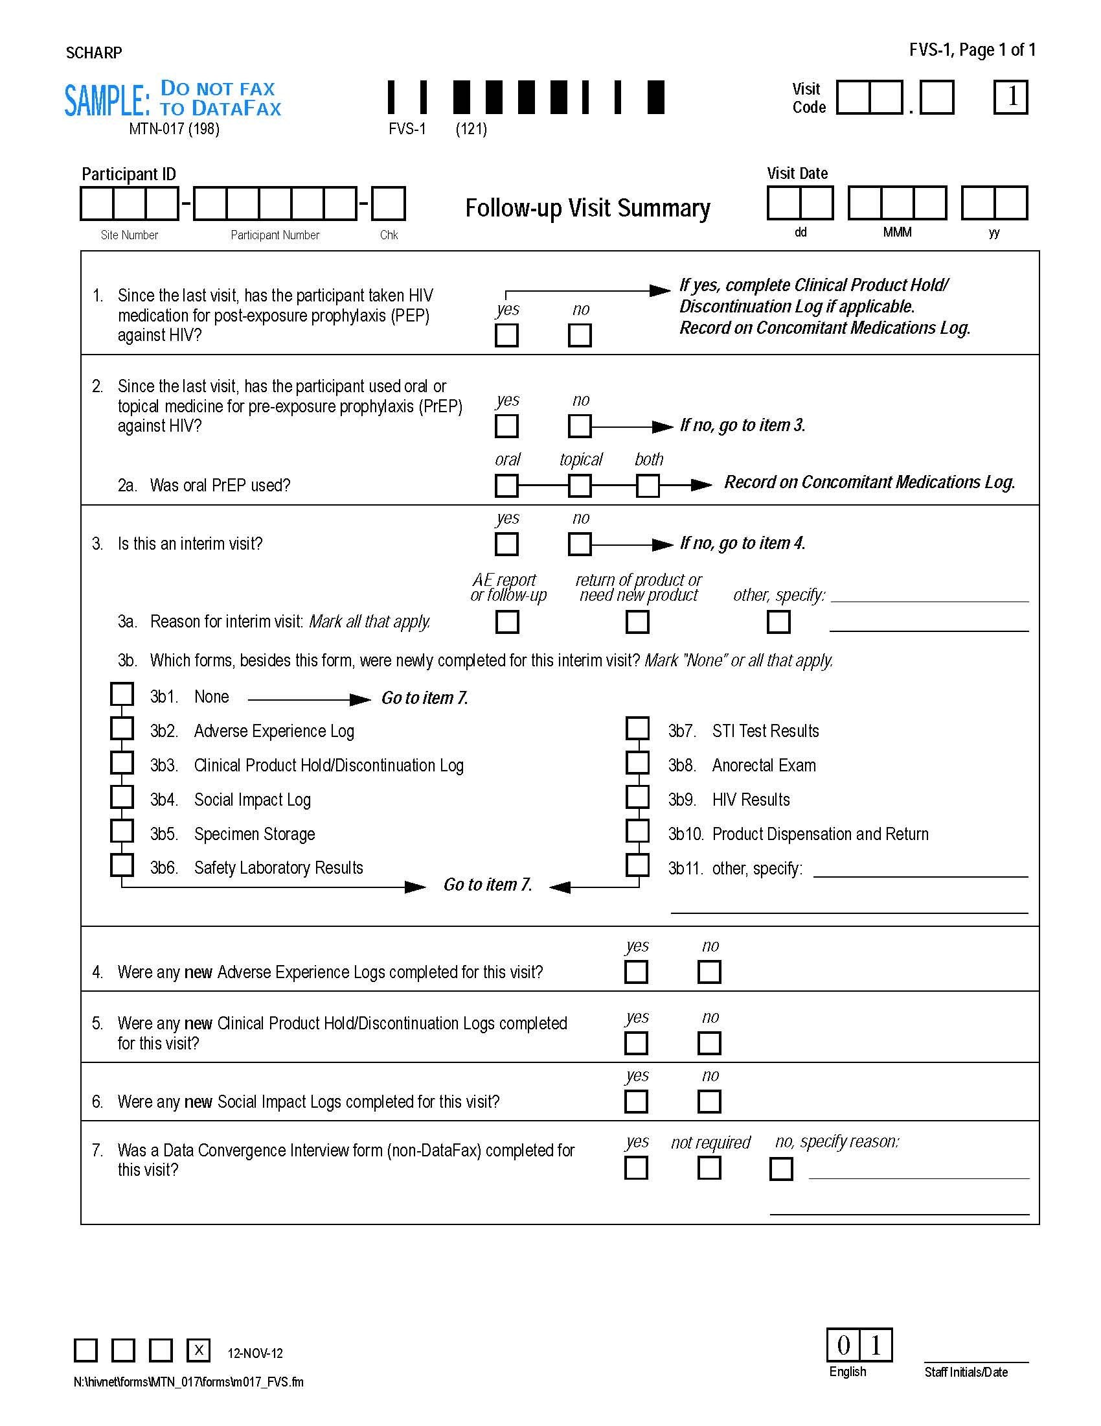
Follow-up Visit Summary
Notes:
Prompts for use of PEP or PrEP since last visit (items 1-2 need to be completed during the visit)
For required visits, asks if any new AE Log pages, Clinical Product Hold/Discontinuation Log pages, or Social Impact Log pages were completed
Just yes/no (# new pages completed)
Indicates whether a visit is an interim visit

Slide 12
Interim Visits
An interim visit = a visit/contact that occurs between required follow-up visits
Required Initiate/Mid-/End Period visit procedures are not conducted
  Either not needed (required visit already completed) or not the purpose of the visit
Ex. A ppt completes Visit 6 on the target day and comes back 5 days later as requested for follow-up of an abnormal rectal exam finding
Ex. A ppt completes Visit 3 on the target day, then returns 7 days later to report a new symptom
Ex. A ppt phones to report a new AE

Slide 13
Interim Visit Documentation
Interim visits documented like required follow-up visits, using the Follow-up Visit Summary CRF (FVS)
  There is no Interim Visit CRF for MTN-017
Interim visit code on FVS lets SCHARP know visit is interim, along with “yes” to item 3
Need sites to document reason for interim visit and CRFs completed for it (FVS-1 items 3a and 3b)
Items 4-6 left blank for interim visits

Slide 14
Interim Visit Codes
If the interim contact results in at least one newly-completed DataFax CRF, the interim visit is assigned an interim visit code
Interim visit codes use the box to the right of the decimal point – assign starting with .1
For the numbers to the left of the decimal point, use the visit code of the most recently-required visit, even if the interim visit date is in the next visit’s window
  The interim visit code will be a number in-between the two visit codes when the interim visit occurred
Ex.: A ppt has an interim visit 7 days after Visit 6 for lab testing; assign interim visit code = 06.1 (in between Visits 6 and 7)

Slide 15
Split Visits
A visit is a split visit when the required visit procedures are split (done) over 2 or more days
The days must all fall within allowable visit window; any required procedures not done within allowable window are missed
For split visits, only 1 FVS is completed, and the Visit Date on this CRF is the date of the first part of the split visit
  All CRFs completed for the split visit are assigned the same visit code (e.g., 7.0)
Can interim visits be split?

Slide 16
Let’s Talk about Termination…

Slide 17
Scheduled Study Exit/Termination
Visit 10 – End Period 3 Visit (visit code 10.0)
Termination Date 7 days after End Period 3
  Marks end of AE reporting period
  ALL AEs occurring thru this date (that site is aware of) are reportable on AE Log CRF
Notes:
all sites, whether doing the biopsy collection or not, will have the termination date 7 days after the exit visit and will collect AEs for consistency purposes.

Slide 18
Early Termination Visits
Will occur if a ppt withdraws consent before Visit 10 (End Period 3)
If consent withdrawn, complete as many Early Termination visit procedures as possible
  Same procedures as Visit 10
  Assign visit code to match where ppt is in follow up schedule at time of early termination
Ppt should not be contacted for future visits, but do ask if s/he wants to be contacted when study results are available

Slide 19
Follow-up Visit Scenarios for Discussion
Scenario 1
A ppt completes his/her Enrollment Visit, and comes back one week later to report a new AE.
Q. What type of visit is this? What visit code is assigned? What CRF is used to document the visit?
A. This is an interim visit, documented with FVS CRF coded as 2.1 (in addition to any other CRFs).

Slide 20
Follow-up Visit Scenarios for Discussion
Scenario 2
A ppt comes in 12 days before Visit 7/End Period 2 (scheduled for target day). Ppt says s/he will return for Visit 7 as scheduled, but needs more condoms today.
Q. If only condoms are provided, are any CRFs needed for this visit? If so, which ones and what visit code is used?
A. No CRFs needed since no new CRFs completed for this visit. Chart note only. Ppt is in allowable window. However, site should wait until target day to complete Visit 7, if ppt is reliable.

Slide 21
Follow-up Visit Scenarios for Discussion
Scenario 3
A ppt comes in for Visit 5/Initiate Period 2 and says s/he will complete the visit, but wants it to be the last. S/he no longer wants to take part in the study.
Q. What CRFs are completed for the visit?
A. Complete procedures and CRFs for Early Termination. Use visit code 5.0.

Slide 22

Follow-up Visits – Key CRFs
Notes:
AE, PDR, Social Harms, and PH Log will be covered in separate presentations

Slide 23
Follow-up Visit CRFs
Initiate Period 2 and 3 Visits
Mid-period
Visits
End Period
Visits
Follow-up Visit Summary
Anorectal Exam
Product Dispensation/Return
Specimen Storage
Rectal Practices
Follow-up LDMS Specimen Tracking Sheet (non-DataFax)
Follow-up Visit Summary
Anorectal Exam
Product Dispensation/Return
Specimen Storage
Rectal Practices
Follow-up LDMS Specimen Tracking Sheet (non-DataFax)
HIV Results
Data Convergence Interview (non-DataFax)
PK Data Convergence Interview (non-DataFax)
Follow-up Visit Summary
Anorectal Exam
Product Dispensation and Return
Specimen Storage
Rectal Practices
Follow-up LDMS Specimen Tracking Sheet (non-DataFax)
HIV Results
Data Convergence Interview (non-DataFax)
PK Data Convergence Interview (non-DataFax)
Safety Laboratory Results
STI Test Results
Follow-up CASI Tracking
Abbreviated Physical Exam (End Period 3/Termination only)

Slide 24
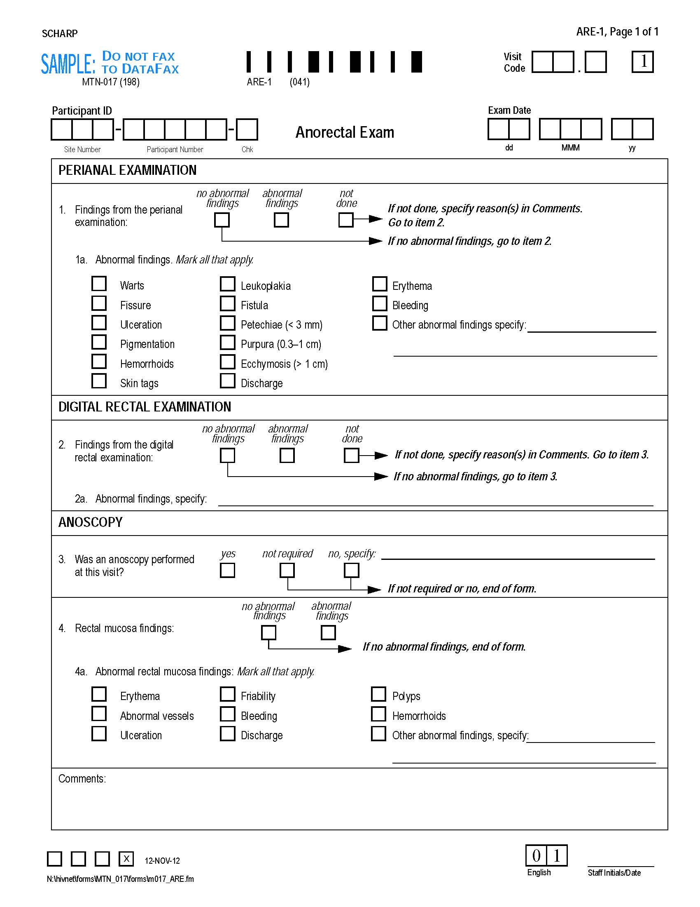
Anorectal Exam
Items 1a and 4a – only mark “other” if none of existing categories apply

Slide 25
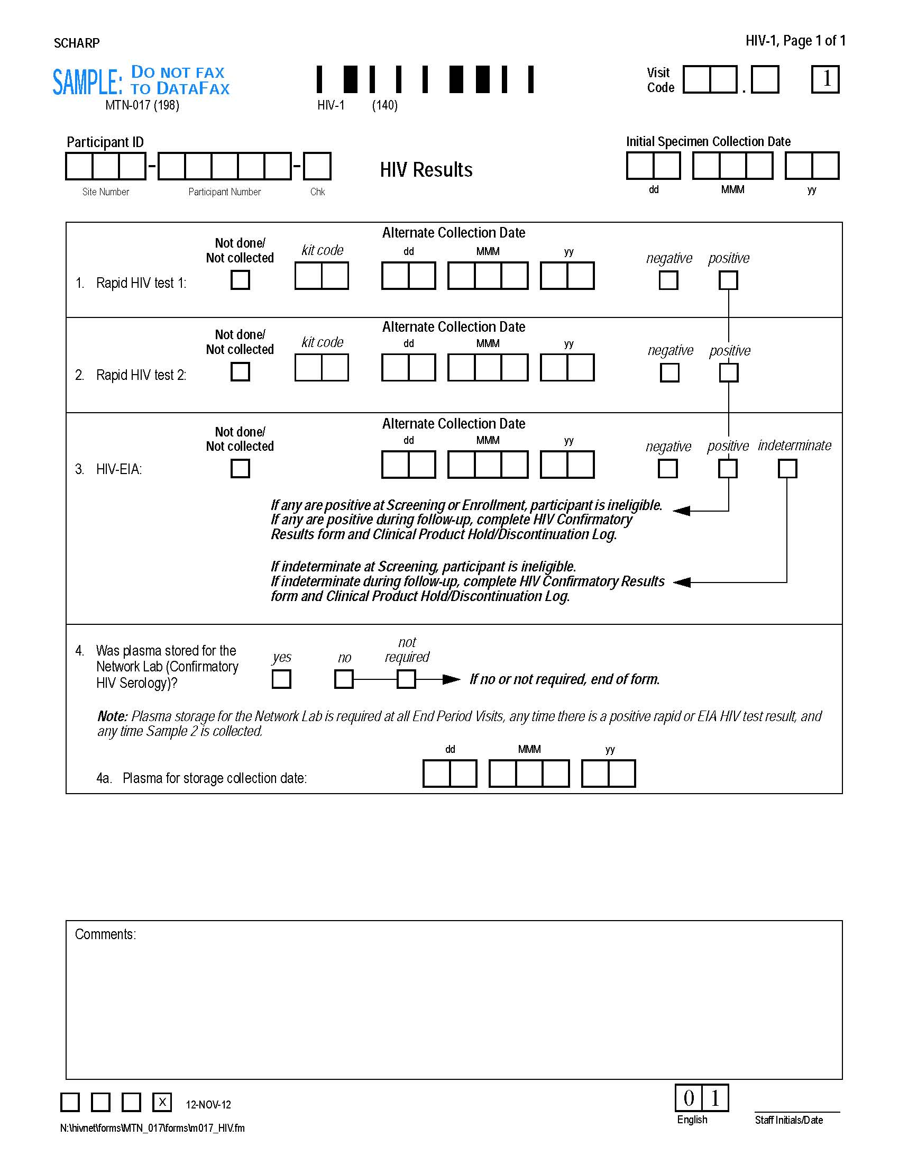
HIV Results
Plasma storage for Network Lab

Slide 26
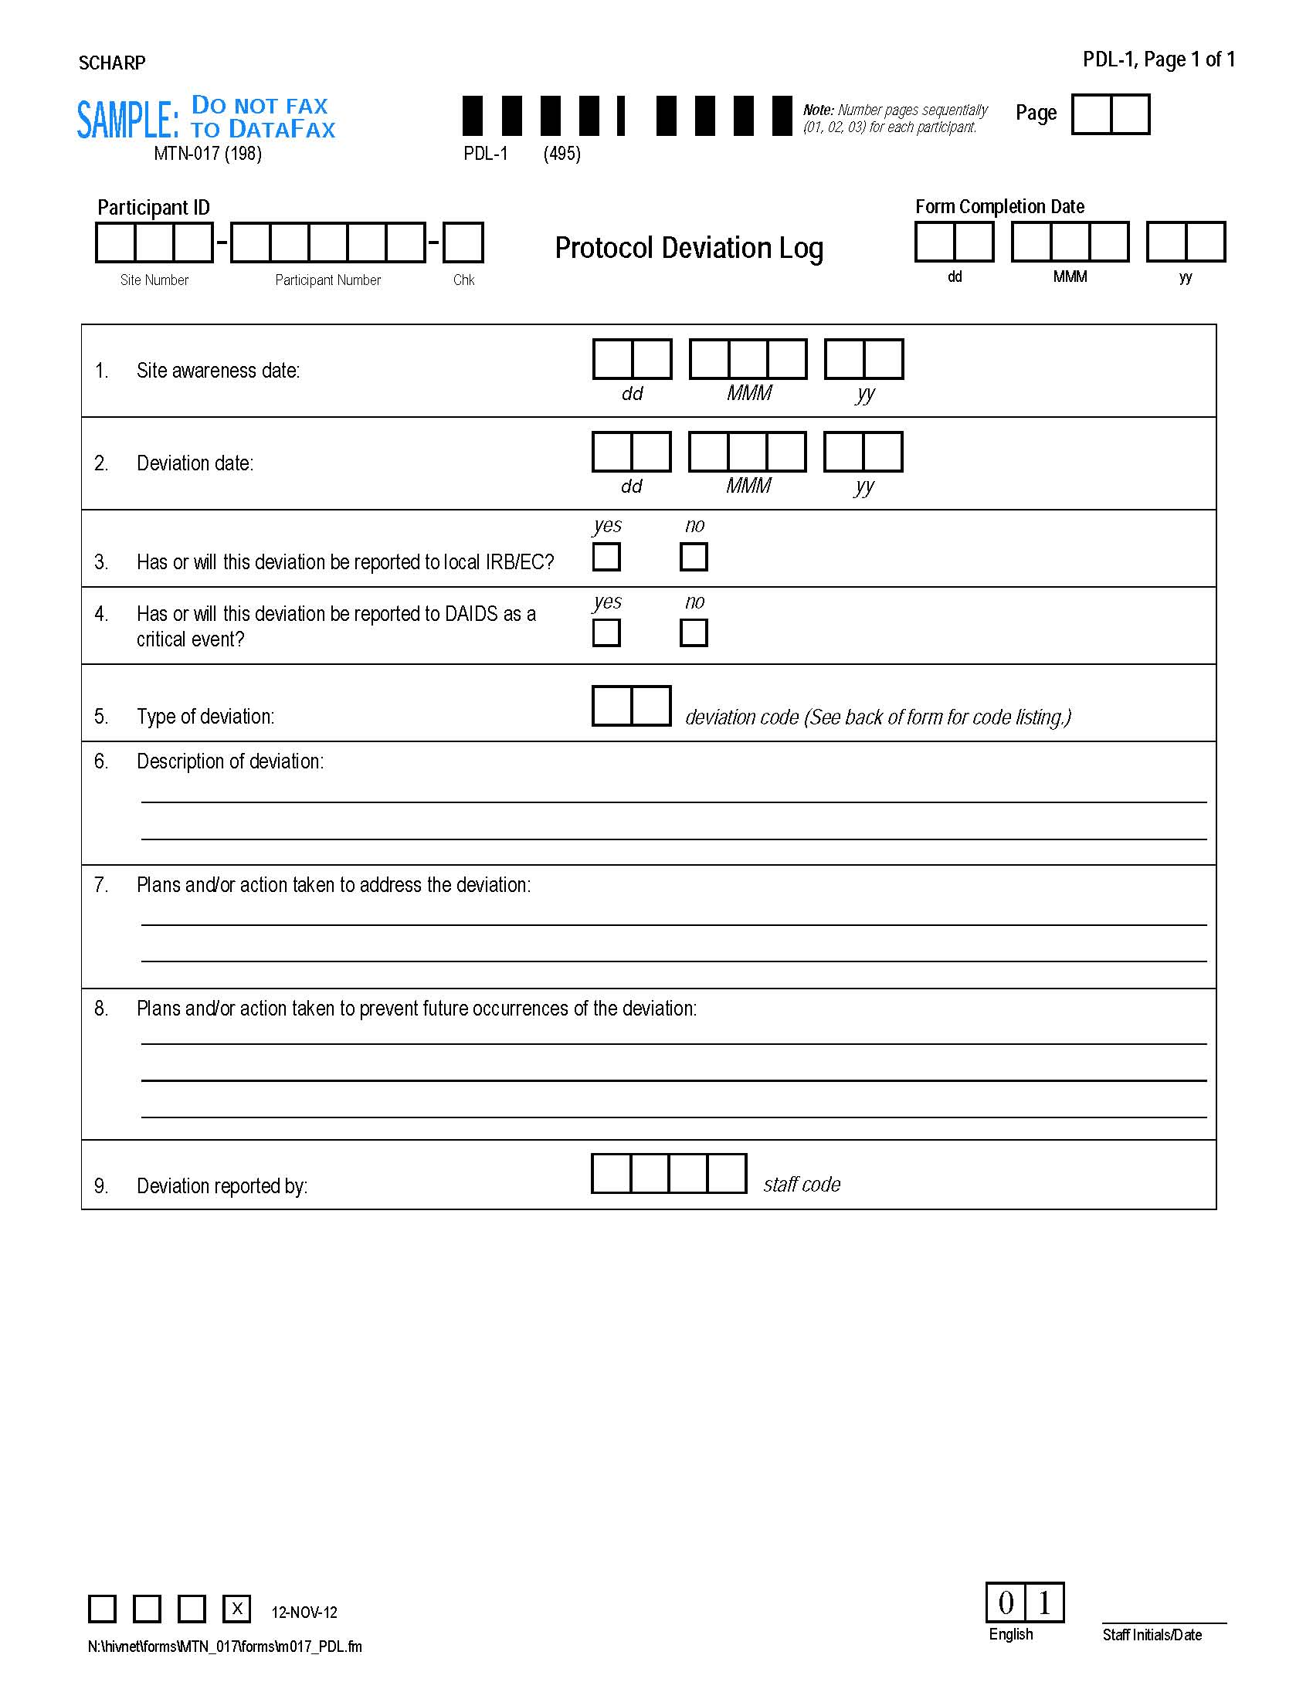
Protocol Deviations Log
Fax once PD identified
Complete one form per PTID and deviation type (code)

Slide 27
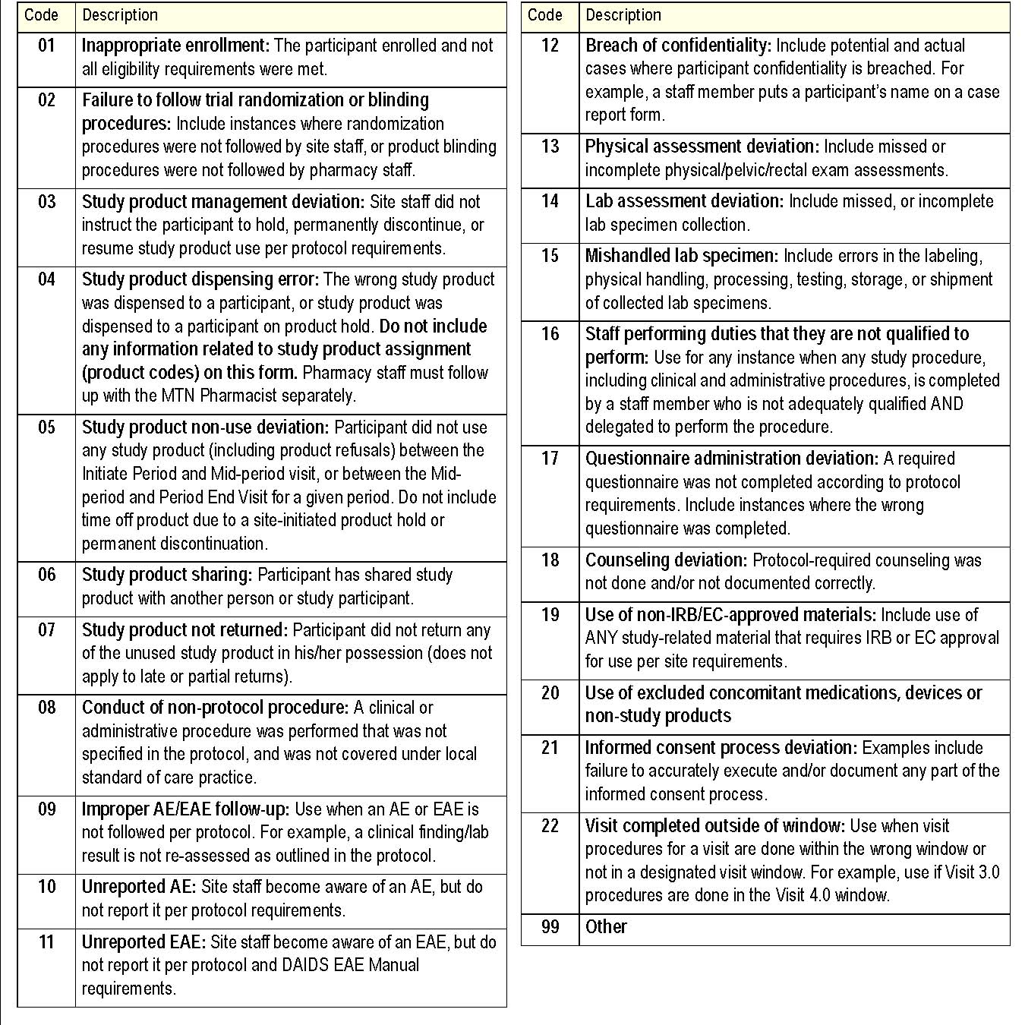
Protocol Deviations Log – item 5
Codes for type of deviation on back of form

Slide 28
Other CRFs
Safety Laboratory Results CRF
  Hemogram, Differential, Serum Chemistries, Urine dipstick, coagulation
STI Test Results
  Syphilis, urine GC/CT, rectal GC/CT, HSV-1/2 blood, HSV-1/2 rectal, Hep. B. antigen, Hep. B. antibody, Hep. C antibody
Abbreviated Physical Exam
  Required at End Period 3/Termination; requirements same as Screening and Enrollment
Specimen Storage
  Samples for NL: Blood for PK (PBMC and plasma), rectal sponges for PK and PD; anal swab for anal HPV typing
Follow-up LDMS Specimen Tracking Sheet
  Samples on Specimen Storage CRF
  May include rectal GC/CT at sites without capacity

Slide 29
Other CRFs
Product Dispensation and Return
  Complete at interim visits as well if product was collected or dispensed
Safety Laboratory and STI Test Results
  Complete at interim visits as well if testing done

Slide 30
Additional CRFs
Follow-up CASI Tracking
  Complete when CASI done
  Required at End Period Visits; complete at other visits only if early termination or to make up CASI if End Period Visit missed
  Item 2 = use to document any problems/issues with the questionnaire

Slide 31
Any Questions At This Time?

