Slide 1
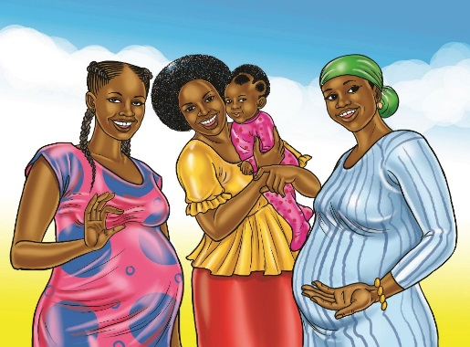
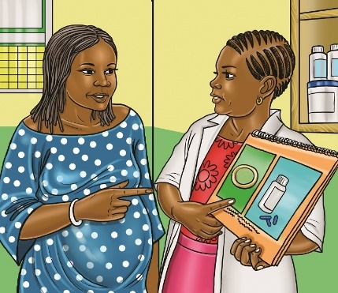
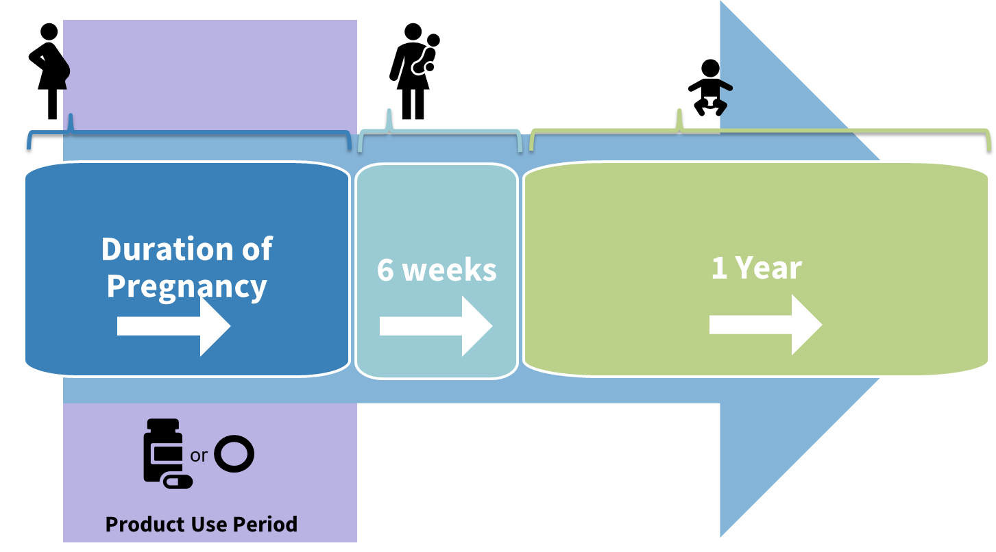
Study Overview
The DELIVER study intends to learn whether two safe and effective HIV prevention methods, the dapivirine vaginal ring and oral Truvada are also safe to use during pregnancy.
Who will join the DELIVER study?
About 550 pregnant women and their babies from Malawi, South Africa, Uganda, and Zimbabwe will take part in the study.
What is the study design?
Women will be enrolled in groups, one group at a time. The first group will be women close to delivery. The groups that follow will be women in earlier and earlier stages of pregnancy.
Safety reviews will be conducted before deciding to enroll the next group of women.
The first group of women have completed follow-up and no safety concerns were identified.
Who can participate?
Women who do not have HIV, are 18-40 years old with a healthy pregnancy carrying one baby, and who meet other eligibility criteria can participate.
Women willing to be assigned by chance to use either daily oral Truvada or the monthly dapivirine vaginal ring during the remainder of their pregnancy.
Women planning to deliver at a health center or hospital, and willing to enroll their baby in the study.
Study staff can provide more information about which group is currently enrolling and what information is available from previously enrolled groups.
How are study products assigned?
Participants will be randomized (assigned by chance) to use either the dapivirine ring or oral Truvada pills. Neither participants nor study staff can decide which product participants receive.
What is the visit schedule?
Women will have regular study visits and phone contacts for the remainder of their pregnancy.
Women will continue study visits and phone contacts until 6 weeks after delivery, including one study visit that will occur in the first 2 weeks after delivery.
The baby’s first visit will be scheduled as soon as possible after delivery. Babies will complete up to 4 study visits over about 12 months.
What will women do at their study visits?
Receive either one new ring or a month’s supply of pills each month for the remainder of their pregnancy.
Have health exams, answer questions about their health, provide vaginal fluid, blood and urine samples for testing and allow study staff access to medical records.
Receive counseling about how to protect themselves from HIV and other STIs.
Women may answer questions about use of their assigned study product and their sexual behaviors. Some discussions may be audio-recorded.
Bring their baby to the clinic for health exams, blood draws, and laboratory tests to check their health, including testing for HIV if needed.
Answer questions about their baby’s health.
MTN-042 Study Overview Factsheet, V2.0, 27AUG2021

Slide 2
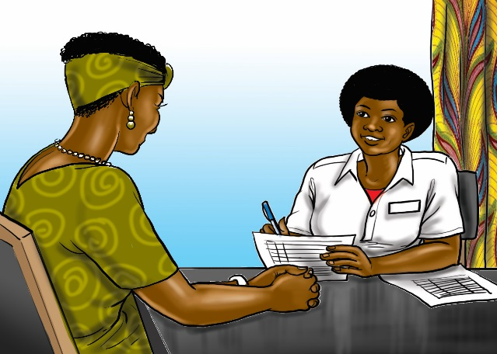
How will participant samples be used?
Blood, pelvic and urine samples taken at study visits will be tested to monitor the participant’s health and answer the study research questions. Participants will receive test results when they are available. Samples are stored in special laboratories and only study staff have permission to access them.
How long are study visits?
Study visit length depends on the type of visit. Most visits will last a few hours, but some may be shorter or longer. Study staff will try to work with participants’ schedules.
Does being in the study cost anything?
No, there is no cost to participate in the study. The study staff will reimburse participants for their time and effort, and cost of trips to come to the clinic.
What are the risks of joining the study?
Women or their babies might experience side effects from the drugs in the study products.
Participants may feel discomfort from having blood tests or physical exams done.
Women might feel uncomfortable answering questions about their personal life.
Women might feel worried about getting test results for themselves or their babies.
Others may find out about being in the study and may treat women or their babies poorly or unfairly.
How will risks be addressed?
Most procedures done in this study are routine medical procedures and pose little risk to women and their babies. The study staff will help with any health problems or side effects that happen during the study, and provide counseling. Staff will keep all participant information private.
What are the benefits of joining the study?
Women and their babies will have access to medical exams, tests, clinical care, and care referrals. Study staff will provide women counseling, and offer condoms.
Women will have access to the dapivirine ring or oral Truvada as an HIV prevention method. If used consistently, these products can help reduce a woman’s and her baby’s risk of HIV.
Information learned from this study may help expand available HIV prevention options for pregnant and breastfeeding women.
What if participants get HIV during the study?
Being in this study will not cause HIV infection for women or their infants. However, it is possible for anyone to get HIV or other STIs from sex or other risky activities.
If women or their babies test positive for HIV during the study, study staff will help them get treatment and other services for HIV. Women will stop using their assigned study product, but they and their babies can still come for study visits.
Protecting choices
Women are free to make their own choice about joining the study and may withdraw participation at any time.
Participants are encouraged to ask questions and involve their partner(s) or other individuals who are important to them in their decision-making. Staff can provide study information to share with loved ones, or invite them to the clinic to learn more about the study.
For more information about DELIVER, go to: http://www.mtnstopshiv.org/news/studies/mtn042
Contact study staff <site name contact information>
MTN-042 Study Overview Factsheet, V2.0, 27AUG2021

