Slide 1

MTN-033
An Open Label Randomized Phase 1 Pharmacokinetic Study of Dapivirine Gel Administered Rectally to Seronegative Adults
Protocol Overview

Slide 2


Slide 3

Protocol Overview
Phase 1, single site study
Enroll 16 evaluable participants
Men and transgender women 18 years old and older
Participants will be followed for about a month

Slide 4
Why Do MTN-033?
Rectal microbicides needed for individuals at risk of HIV infection through RAI
RAI is facilitated by use of a lubricant
Rectal gel has advantage of familiarity
Community desire for a rectal microbicide as lubricant
Data is needed to support this

Slide 5
Protocol Objective
Characterize the systemic and compartmental pharmacokinetics of dapivirine gel
Endpoint will be PK dapivirine concentrations
  Rectal fluid
  Plasma
  Rectal mucosal homogenates

Slide 6
Other Objectives
Secondary Objectives
  Safety
  Acceptability
Exploratory Objectives
  Ex Vivo Efficacy
  Biomarkers of Mucosal Safety

Slide 7
Who Can Join MTN-033
Men and transgender women 18 or older who are HIV-1/2 uninfected and provide written informed consent
In good health, willing to follow study requirements and provide adequate locator information (defined by site SOP)
History of RAI at least once in past year
Will not take part in other research studies
Will abstain from RAI and other forms of rectal stimulation for 72 hours before and after each study visit

Slide 8
Who Cannot Join MTN-033
Individuals with clinical risks as indicated by blood tests at screening
  Hgb grade 1 or higher
  Platelet count grade 1 or higher
  WBC grade 2 or higher
  AST or ALT grade 1 or higher
  Serum creatinine > 1.3 ULN
  INR >1.5 ULN
  Positive HCab or HBsAg
Notes:
Note: with the exception of HCV and HBV, participants may be retested during the screening process and if a non-exclusionary result is documented within 30 days of providing informed consent for screening, the participant may be enrolled.

Slide 9
Who Cannot Join MTN-033
Anticipated use or unwillingness to abstain from certain meds during study
  Anticoagulant medications
  Aspirin (>81 mg/day)
  NSAIDS
  Other drugs associated with increased likelihood of bleeding
  Rectally –administered meds/products containing N-9 or corticosteroids
  CYP3A inducers and inhibitors
  Hormone replacement therapy (tablet, injectable or gel)

Slide 10
Who Cannot Join MTN-033
Ever had known adverse reaction to latex or polyurethane, components of study product, applicator or CSD
Use of PrEP 1 month prior to enrollment or anticipated use or unwillingness to abstain from PrEP during the study
Use of PEP in 6 months prior to enrollment
Use of systemic immunomodulatory meds within 6 months of enrollment
Use of non-therapeutic injection drug within 12 months

Slide 11
Who Cannot Join MTN-033
At screening:
  participant report of treatment for anogenital STI (after diagnosis) in past 3 months
  participant-reported symptoms and/or clinical or laboratory diagnosis of active anorectal or reproductive tract infection (RTI) requiring treatment; symptomatic UTI
At enrollment:
  active anorectal infection, RTI requiring treatment or symptomatic UTI
In last 6 months prior to enrollment, RAI without a condom and/or penile vaginal intercourse with a partner who is known to be HIV-positive
Within 30 days of enrollment, participation in research studies involving drugs, med devices, genital/rectal products or vaccines

Slide 12
Randomization
Participants will be randomized to product sequence
Additionally, tissue and rectal effluent sampling PK will be randomized: 1 hour or 4 hours on the day of dosing
The randomization plan will be for all primary enrollments and replacement enrollments

Slide 13
Product Sequencing
 | N | Period 1 | Washout ~2-4 weeks | Period 2
Sequence A | 8 | One dapivirine gel applicator (2.5 g) administered into rectum |  | Up to 10 g administered into rectum via coital simulation device
Sequence B | 8 | Up to 10 g administered into rectum via coital simulation device |  | One dapivirine gel applicator (2.5 g) administered into rectum

Slide 14
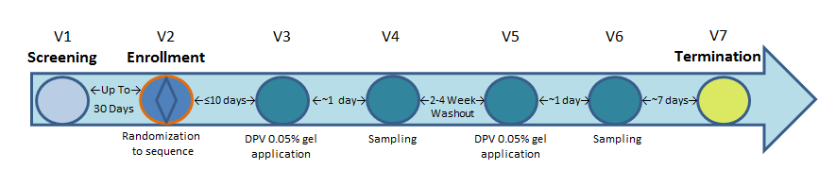
Visit Schedule

Slide 15
MTN-033
An Open Label Randomized Phase 1 Pharmacokinetic Study of Dapivirine Gel Administered Rectally to Seronegative Adults
Visit Procedures

Slide 16
Visit 1 – Screening
Takes place up to 30 days before Enrollment
Can be done over multiple visits
Only two screening attempts permitted
Remember – if there is an indication please
  Treat or prescribe treatment for RTI/UTI or STI
  Get a urine dipstick/culture
  Complete anorectal exam for detection of HSV 1/2

Slide 17
Assessing Eligibility
Assess Eligibility
Locator Info
Lab Evaluations
Clinical Exams
Medical/
Medication History
Behavioral Assessment
Informed Consent
Notes:
Screening-an initial assessment of eligibility. The following must occur:
Provision of IC and assessment of comprehension, adequate locator information
Assess behavioral eligibility
Collect blood, urine, rectal and other samples for STI testing, kidney and liver functioning, clotting concerns
Conduct physical, rectal and genital exams to evaluate protocol exclusion criteria and assess overall health and baseline genital and rectal conditions.

Slide 18
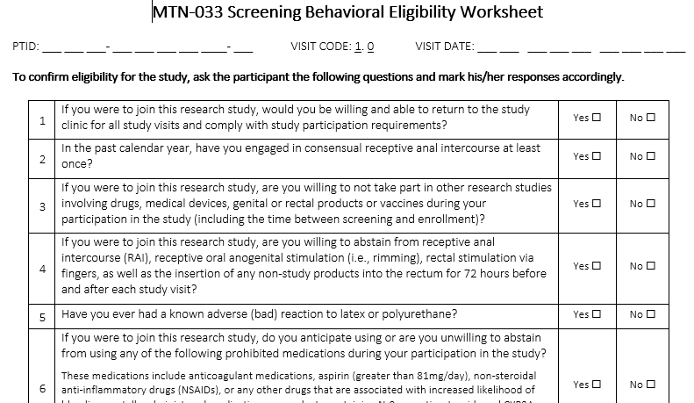
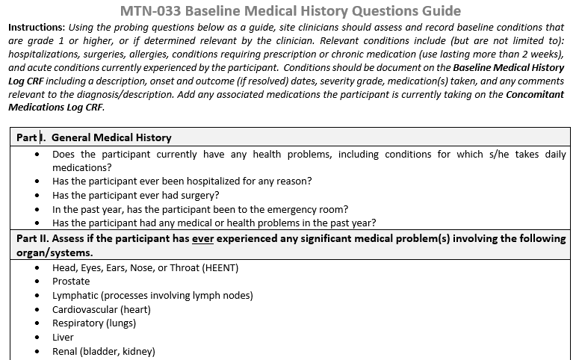
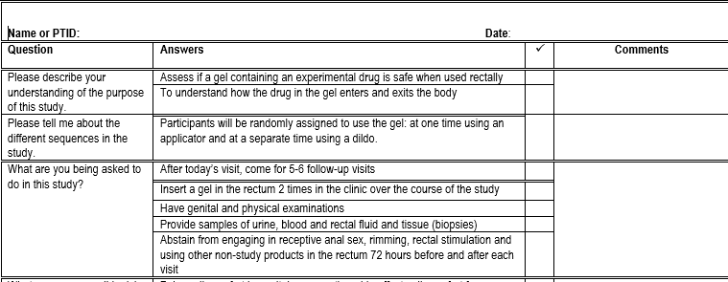
Screening Tools

Slide 19
Visit 2 – Enrollment
Occurs within 30 days of screening
This is visit where baseline is captured
Longer visit as rectal tests are completed
  Fluid for microbiome
  Enema effluent for PD baseline prior to biopsy collection
  Tissue for ex vivo challenge, histology, transcriptomics, proteomics

Slide 20
Confirming Eligibility
Confirm Eligibility
Locator Info Review
Lab Evaluations
Clinical Exams
Update Medical/
Medication History
Behavioral Assessment
Notes:
Enrollment confirmation/verification of eligibility. The following must occur:
Assess IC and willingness to continue study participation
review/update as needed adequate locator information, medical/medication history
Re-assess behavioral eligibility and complete baseline CASI
Collect blood for archive and HIV testing
Repeat physical, rectal and genital exams to evaluate protocol exclusion criteria and assess overall health and baseline genital and rectal conditions.

Slide 21
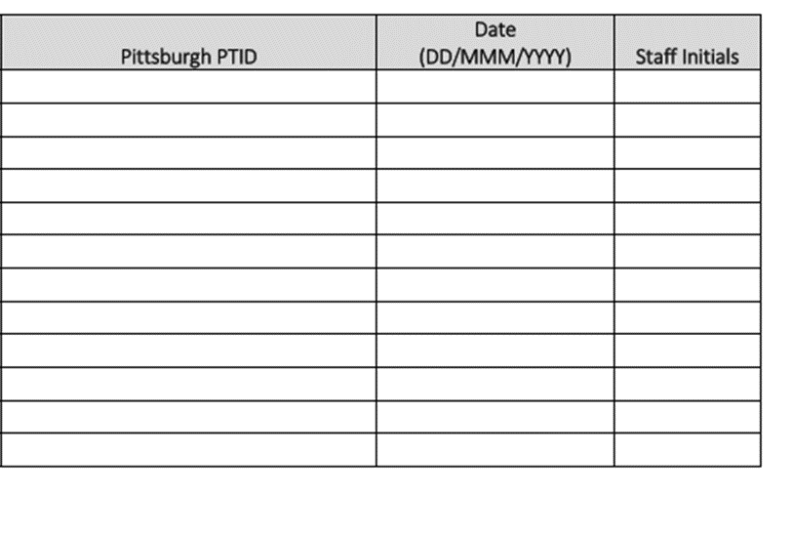
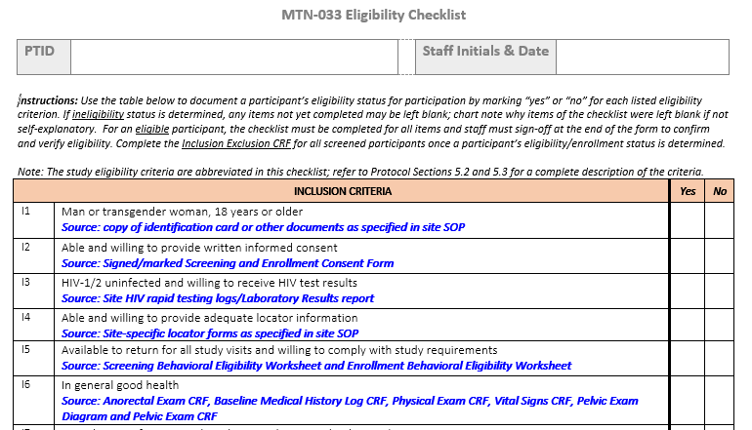
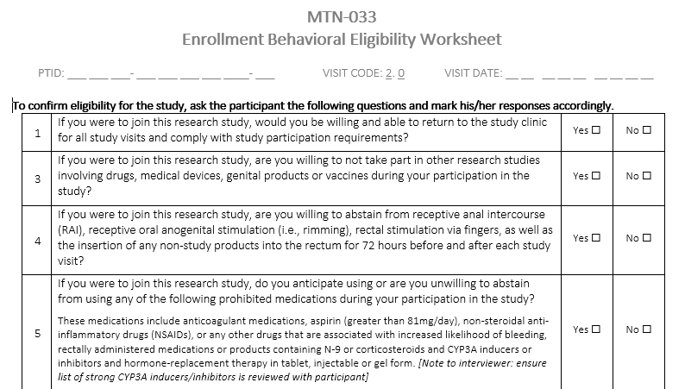
Enrollment Tools
Notes:
Eligibility checklist, Enrollment Behavioral Eligibility Worksheet, CASI ID Log

Slide 22
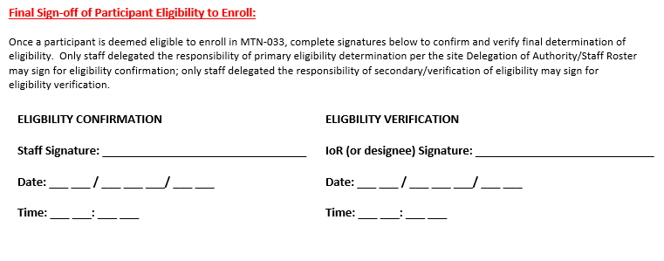
Eligibility Confirmation, Verification and Signatures
Once eligibility status is confirmed by reviewing and completing the Eligibility Checklist, the IoR/designee and a second staff member should sign and date the bottom of the Eligibility Checklist verifying eligibility PRIOR to randomization
Notes:
Must be done PRIOR to randomizing the participant in Medidata
Documents final participant eligibility for all inclusion/exclusion criteria. To be completed on day of enrollment by designated staff.
Note: The IoR or designee should complete and a second staff verifying eligibility must complete.

Slide 23
Randomization
Time Assignment
Gel Application Sequence
Dosing Visits 3 and 5
Rectal Fluid/Tissue
1 or 4 hours post dose
Applicator → Coital Simulation Device
OR
Coital Simulation Device → Applicator
Notes:
Participants will be assigned a time point in which they will provide rectal fluid and tissue samples at Dosing Visits 3 and 5. During these visits, participants will either provide samples 1 hour or 4 hours after study product is administered. This assignment will be maintained for each dosing visit.
Participants will also be told the order in which they will use the study product application methods at Dosing Visits 3 and 5 (either insert the study gel into the rectum using either an applicator followed by insertion using a coital simulation device (dildo) or vice versa)
SCHARP will review in more detail how to randomize ppt within Medidata

Slide 24
Visit 3 – Period 1 Dosing Visit &
Visit 5 – Period 2 Dosing Visit
Visit 3 should occur within about 10 days of Enrollment visit
Visit 5 ideally occurs 2-4 weeks after Visit 4 (Sampling visit)
If there are any unresolved abdominal, genital or anorectal AEs (any grade) or unresolved grade 3 or 4 AEs, the PSRT must be contacted before a Visit 5 can occur
Visits will take more than 4 hours to accommodate serial PK sampling

Slide 25
Visit 3 and Visit 5 –Dosing Visits
Medical/medication history and locator info review
CASI and IDI
Rectal Exam
Blood for PK (0, .5, 1, 1.5, 2, 2.5, 3, 4)
Enema Effluent for PK/PD (hour 1 or 4)
Rectal Tissue for PD/PK (hour 1 or 4)
Rectal fluid for PK (hour 1 or 4)
Study Product Administration

Slide 26
Visit 4 – Sampling Visit &
Visit 6 – Sampling Visit
Occurs approximately 24 hours after gel application
In addition to the in-clinic visit, remind participants to call within 72 hours to report any issues related to the collection of samples via the flexible sigmoidoscopy
The procedures completed at these visits will also be the procedures that will be completed if an Early Termination is needed (SSP will provide full details)

Slide 27
Visit 4 and Visit 6 – Sampling Visits
Visit 4
Visit 6
Medical/medication history and locator info review
Rectal Exam
Blood for PK
Enema Effluent for PK/PD
Rectal Tissue for histology, transcriptomics, proteomics, PK
Rectal fluid for PK, microbiome
Medical/medication history and locator info review
Rectal Exam
Blood for PK, HIV, Chemistries
Enema Effluent for PK/PD
Rectal Tissue for histology, transcriptomics, proteomics, PK
Rectal fluid for PK, microbiome

Slide 28
Visit 7 – Termination Visit/Contact
Occurs approximately 7 days after Visit 6
Contact can either be via phone or as a clinic visit
Purpose is to assess AEs as a result of product or procedures
This serves as the participant’s termination from the study

Slide 29
Missed Visits (SSP Section 5)
If Visit 3 or 5 is missed = REPLACEMENT MAY BE NECESSARY
  Consult Management Team for guidance, decisions made on case-by-case basis
If Visit 4 is missed: participants should return to the clinic as soon as possible to make up the following procedures:
  Review/update locator information, medical and medication history
  Assess for AEs
  Provide protocol counseling
  Collect blood for PK o Conduct rectal exam
  Collect required PK, PD and mucosal safety samples (rectal fluid, tissue and effluent)

Slide 30
Missed Visits (SSP Section 5)
If Visit 6 is missed: participants should return to the clinic as soon as possible to make up the following procedures
  Review/update locator information, medical and medication history
  Assess for AEs
  Provide protocol counseling and HIV pre/post and risk reduction counseling
  Collect blood for PK, serum chemistries and HIV testing
  Conduct rectal exam and collect required PK, PD and mucosal safety samples (rectal fluid, tissue and effluent)

Slide 31
Permanent Product Discontinuation
Prohibited mediation use (Heparin, Lovenox®, Warfarin, Plavix®)
Hormone Replacement Therapy
Unable or unwilling to comply with study procedures or otherwise might be at undue risk to safety and well being by continuing product use, according to site IoR/designee
Anorectal STIs
Acquisition of HIV
Grade 3 AE RELATED to study product
Grade 4 AE (regardless of relationship)

Slide 32

What are your questions?

Slide 33

MTN-033
Study Product Considerations
Cindy Jacobson/Lindsay Kramzer
Microbicide Trials Network
Pittsburgh, PA

Slide 34
Presentation Overview
Study Gel Prescription Completion
Study Gel Supply and Labeling
Chain of Custody, Accountability, Unused Gel Returns
Study Gel Request Slip Completion
Prohibited Medications
Study Gel Complaints

Slide 35
Reference Materials
MTN-033 Protocol, Version 2.0
  Section 6
MTN-033 SSP Manual
  Section 6

Slide 36
Study Product Regimen & Visit Schedule

Slide 37
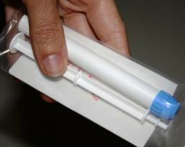
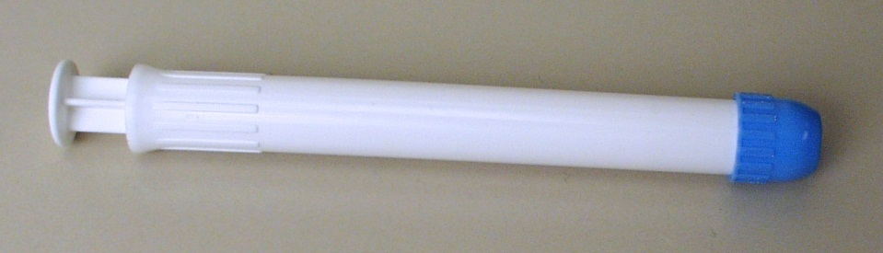
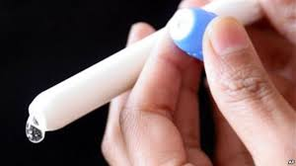
Study Product – Dapivirine 0.05% Gel
One pre-filled applicator contains:
  2.5 grams (2.5 mL) of Dapivirine 0.05% gel (1.25 mg of dapivirine)
Store at controlled room temperature, 77°F (25°C). Excursion between 59-86°F (15°C to 30°C) are permitted.
Notes:
Can do this one quickly sites are familiar

Slide 38

Coital Simulation Device (CSD)
DOC JOHNSON® The NaturalsTM
Cock and Balls, Dildo

Slide 39
Visit 2/Day 0: Enrollment Visit
Inclusion/Exclusion Criteria CRF and Randomization CRF must be completed by clinic staff for a participant to be enrolled/randomized into the study.
The study database will assign the participant to a dapivirine gel sequence (Sequence A or B)
A participant is considered officially enrolled after the completion of the Randomization CRF, as evidenced by the appearance of a randomization date and time on this CRF.
Site pharmacy staff will receive an email notification from the Medidata system when a participant is randomized/enrolled by site clinic staff.
Notes:
The participant is enrolled if the I/E and Randomization CRFs are both completed and the first question on the Randomization form, “is the participant ready to be randomized”, is marked “yes” (this will account for screen out participants).
In the event there is a technical issue and the site does not receive the randomization confirmation email, please follow the steps detailed below:
Confirm the participant was successfully randomized in Medidata. (see #1 above)
Inform the site pharmacist that a randomization confirmation email for the randomized participant was not received.
When final product preparations are to begin, provide the pharmacist with the PTID of the randomized participant and request that the pharmacist log into Medidata Balance, locate the PTID, retrieve the treatment assignment, and prepare study product accordingly.
Document all steps in the participant chart.

Slide 40
Visit 3: Period 1 Dosing Visit
5: Period 2 Dosing Visit
Completion of Prescription by clinic staff/authorized prescriber will occur at Visit 3 and Visit 5
Prescription is a 2 part no carbon required (NCR) paper document. The top white is the original (pharmacy) and the bottom is yellow (clinic).
Prescriptions are provided by the MTN LOC Pharmacy to the site pharmacy staff who, in turn, provides this document supply to site clinic staff

Slide 42
MTN-033 Prescription
When completing the prescription, place the cardboard flap under the copy (clinic prescription)
Double check the accuracy of all entries
Errors may be corrected in blue or black ink by putting a line through and initialing
Retain the yellow copy for the participant study notebook in the clinic
Deliver white copy to pharmacy

Slide 43
MTN-033 Prescription
The pharmacist will review the prescription.
If an error is noted, the white and yellow copies must be individually corrected by an authorized prescriber with identical information on both copies (correction, initials, date).
  The pharmacist will also let you know if he/she finds a discrepancy between information on the prescription and Pharmacy Dispensation CRF.
If no problems are noted, the pharmacist will dispense the study gel.

Slide 44
MTN-033 Study Gel Label
PoR will indicate

Slide 45
Chain Of Custody
The study product must be tracked with documentation, from the pharmacy to the participant, all steps in between and the return documented in the clinic.
Study product may be prepared by the pharmacist based on either original documents or faxed copies, but will not be released to the clinic staff until the original prescription is received.
Upon receipt of a completed and signed prescription, the PoR will dispense study gel per the Study Visit Schedule.

Slide 46
Chain Of Custody
Pharmacy site-specific Chain of Custody SOP
Chain of Custody from pharmacy staff to clinic staff is documented on the
  Record of Receipt of Site-Specific Study Gel (study-specific)
  Study Product Transfer Form (site-specific)
  These records are stored in the pharmacy

Slide 47
Record of Receipt of Site-Specific Study Gel

Slide 48
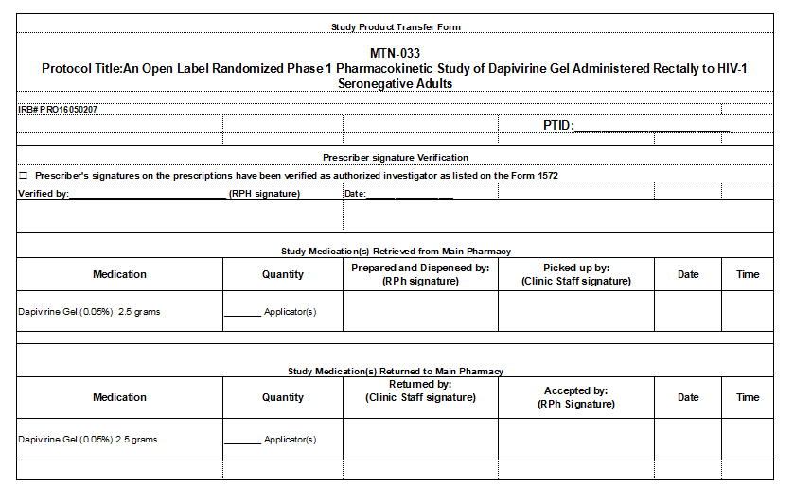
Study Product Transfer Form

Slide 49
Chain of Custody
Clinic Staff Responsibilities
Control access to the study product in their custody.
Clinic staff must document delivery of the study product to designated participants in the participants’ study charts (chart notes, visit checklists, or on other source documents designated for this purpose by clinic staff).

Slide 50
Chain of Custody
Clinic Staff Responsibilities
If study product dispensed for a participant is not provided to the participant, clinic staff must document this in the participant's study chart and return remaining product (unused) to the pharmacy.

Slide 51
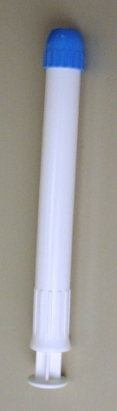
Dapivirine 0.05% Gel Dosing
One DPV gel applicator – 2.5 grams of gel administered from applicator directly into rectum
  Lubricant provided: Good Clean Love
Recorded on Dose Administration CRF

Slide 52


Dapivirine 0.05% Gel Dosing
Up to 10 grams of DPV gel administered into rectum via coital simulation device
Refer to Clinic Instructions & Record for Measuring CSD Gel Dose and Participant Instructions for Use of CSD (Dildo) and Dapivirine Gel
Recorded on Dose Administration CRF

Slide 58
MTN-033 Study Gel Request Slip
Study Gel Request Slip is a 2 part no carbon required (NCR) paper document. The top white is the original (pharmacy) and the bottom is yellow (clinic).
Request Slips are provided by the MTN LOC Pharmacy to the site pharmacy staff who, in turn, provides this document supply to site clinic staff
Clinic staff will complete a request slip, if:
  Additional product is needed/resupply (one or more of the applicators is unusable)
  Temporary product hold
  Product resume after temp hold
  Permanent product discontinuation
  Participant decline of product use
  Product use period completed (Visit 7)

Slide 60
Study Gel Request Slip
This slip can be completed by any authorized clinic staff
  Insert cardboard flap behind the clinic copy
Double check the accuracy of all entries
Errors may be corrected in blue or black ink by putting a line through and initialing
Retain the yellow copy for the participant study notebook in the clinic
Deliver white copy to pharmacy
Once the white and yellow copies are separated errors must be corrected on each sheet separately

Slide 61
Unused Study Gel Return
ONLY unused study gel should be returned to the pharmacy
  Any unused dose including the take home dose
  NO USED GEL APPLICATORS should be returned to the pharmacy
Unused gel is returned to the pharmacy by:
  Clinic staff member or runner
  Depends on pharmacy site-specific Chain of Custody SOP
Documented on Record of Return of Site-Specific Study Gel and Study Product Transfer Form
  These records are stored in the pharmacy

Slide 62
Chain Of Custody
If returning unused gel because damaged or contaminated, record the details on the record
The pharmacy will document and quarantine any returned unused gel

Slide 63
Record of Return of Site-Specific Study Gel

Slide 64
Study Product Transfer Form

Slide 65
Prohibited Medications
Protocol Section 6.8.1
Protocol Section 9.3 – Permanent Discontinuation
  Including at IoR/designee discretion
SSP Section 6
  Section 6.6
  Appendices 6-4 to 6-7

Slide 66
Prohibited Medications
CYP3A4 Inhibitors – strong, moderate, weak?
CYP3A4 Inducers – strong, moderate, weak?
Anticoagulants/Blood Modifier Agents
NSAIDS
PrEP
PEP
Hormone-Replacement Therapy
Immunomodulators
Perianally applied topical steroids and other rectally-administered medications, including products containing N-9

Slide 67
Study Gel Complaints
Study product problem may be noted by pharmacy, clinic, and/or participant.
  May concern dosage form (gel), applicator (barrel, piston, cap, plunger), packaging (overwrap), or other aspect.
Clinic staff will make thorough record of clinic staff or participant complaint.
Clinic staff member will email complaint to site PoR
  PTID, Date of observed issue, date issue was reported, date gel was dispensed, did adverse event occur, nature of issue, picture (if possible and applicable), any other necessary details

Slide 68
Study Gel Complaints
Pharmacy staff will email all study product complaints to MTN LOC Pharmacy.
If the complaint is concerning an unused gel applicator, then the unused gel applicator should be held in quarantine in the pharmacy
If the complaint is concerning a used gel applicator, then the clinic staff should process the used study product per standard operating procedures for used study products (if applicable)

Slide 69
Study Other Items Supplied to Clinic
Male condoms
4mL sachets of lubricant for applicator insertion
4oz tubes of lubricant for procedures
Weigh boats
CSD
An order does not need to be submitted for these items

Slide 70
Contact Information
If you have any questions, please do not hesitate to contact us:
Cindy Jacobson
(412) 641-8913
cjacobson@upmc.edu
Lindsay Kramzer
(412) 641-3865
fergusonlm@upmc.edu
Questions? Thank you!

Slide 72
MTN-033 Training
Julie Ngo
SCHARP
March 2, 2018

Slide 73
Presentation Overview
Key differences between MTN-026 and MTN-033
Study regimen and visit schedule
Visit calendar tool
Missed, Interim, and Split Visits
CRFs summary
Pharmacy Dispensation and Dose Administration forms
Reports and Study Monitoring
Resources in Rave
Query Management

Slide 74
Key Differences from MTN-026
Only men and transgender women (no women)
2 dosing visits and 2 sampling visits
  No intensive sampling
Coital simulation device and applicator used
  Sequence randomization
  Product application clinic instructions provided
  Minimal CRF Changes

Slide 75
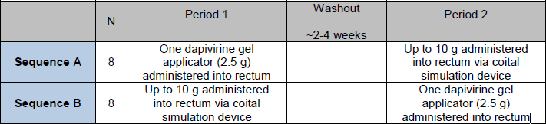
Study Regimen and Visit Schedule
  Single dose administered at Visit 3, followed by a 2-4 week washout period, then a single dose administered at Visit 5

Slide 76
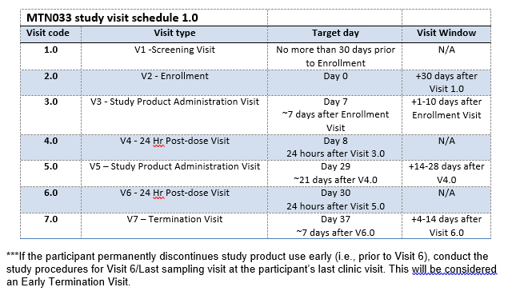
Visit Windows
Notes:
Enrollment may be scheduled within 30 days after initial Screening Visit.
Ideally, follow-up visits will occur on the target date. If visit cannot occur on target date, it should be completed within visit window. Note there are no visit windows for Visit 4 and 6.
Some visits have visit windows while others do not. This is due to the timing of the visit (24 hour post dose visits)

Slide 77
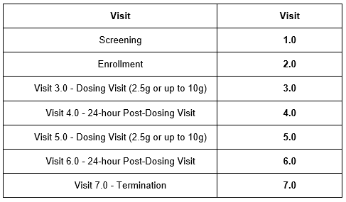
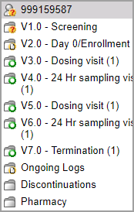
Visit Codes
Visit name and visit code automatically appear in Medidata Rave in pre-defined study visit folders
Notes:
Visit Codes are used to indicate at which point in a ppt’s trial participation an event occurred
Do not need to enter visit code on eCRFs as the forms for a given visit are within the pre-defined study visit folder.
If an early termination visit is conducted, the visit code of the early termination visit will depend on where the participant is at in her visit schedule at the time of early termination. For example, if a participant withdraws from the study at Visit 5, his or her early termination will be on that visit date and the visit code of the early termination visit will be 5.0.

Slide 78
Visit Calendar Tool
Excel tool provided by SCHARP to calculate the screening window and last day to Enroll
First tab creates the follow-up visit schedule/calendar for a ppt with actual dates
  Requires entry of PTID, full Enrollment Date, Visit 3 and 5 actual visit dates
  For each required follow-up visit, the target date, and allowable windows (if applicable) are generated
  Blank column provided for site to write-in actual visit dates
For easy reference, print and placed in the ppt’s study notebook once ppt has enrolled

Slide 79
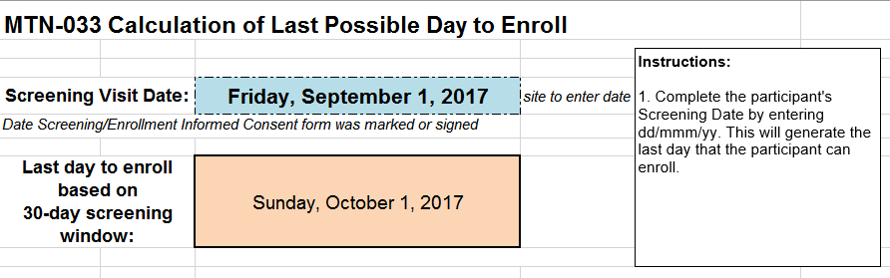
Last Day to Enroll Calculator
Notes:
This is available in the second tab of the visit window calendar tool. Tool is posted on MTN web site.
Allows sites to enter the Screening Visit Date and calculate last day to enroll based on the 30-day screening visit window.

Slide 80
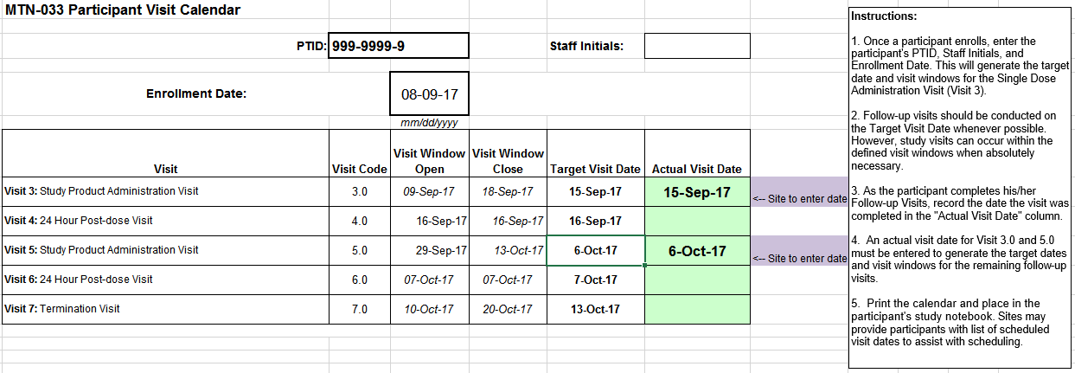
Visit Calendar Tool
Notes:
An actual visit date for Visit 3 and 5 must be entered to generate target dates/windows for remaining f/u visits.

Slide 81

Missed Visits
A follow-up visit is missed once allowable window closes if he/she has not completed any part of visit
If a visit does not have a window and the participant cannot come in on target day, the visit is considered missed.
    E.g., participant completes Enrollment and Visit 3 (Dosing visit), but is not able to come back into the clinic until Visit 5. The Visit 4 Sampling Visit is considered missed.
    E.g., The Visit 4 and 6 have no visit windows, thus are missed
If a participant misses Visit 3 or Visit 5 (the dosing visits), the management team should be notified as this participant will need to be replaced.
Missed visits are not made up. Rather, sites should make every attempt to retain participants at future visits.

Slide 82
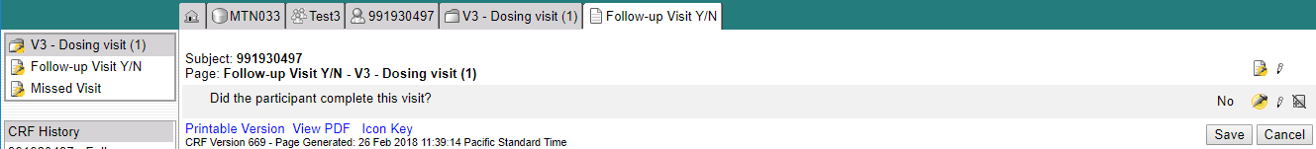
Missed Visits
Missed visits are documented in the study database using the Missed Visit CRF
The Missed Visit form will let SCHARP know not to expect any other forms for that participant at that study visit (with the exception of the Follow-up Yes/No CRF).
The Missed Visit CRF is completed in lieu of a Protocol Deviations Log CRF

Slide 83
Interim Visits
Visits that take place between scheduled visits
  Additional study procedures and/or data collection conducted outside of what is specified in protocol for required study visit (Example: Report of new AE, issue with study product, etc.)
  Required study visit procedures conducted outside visit window, either to make up certain procedures from missed visit or conduct Visit 6 Early Termination Visit procedures due to early product discontinuation
All interim contacts (e.g., phone calls and/or clinic visits) will be properly documented in study files and on applicable CRFs
Notes:
Required procedures: Procedures required during an interim visit will depend on the reason for the visit. For example, if a participant presents to the site to report an AE, all clinically-related procedures to assess the AE and required documentation would be the required procedures for that interim visit.

Slide 84
Interim Visit Codes
If the interim contact results in at least one newly-completed eCRF, the interim visit is assigned an interim visit code
Interim visit codes use the box to the right of the decimal point – assign starting with .1
For the numbers to the left of the decimal point, use the visit code of the most recently required visit, even if the interim visit date is in the next visit’s window or if the visit was missed
The interim visit code will be a number in-between the two visit codes when the interim visit occurred
  E.g., a ppt has an interim visit 2 days after his/her Visit 6 to follow-up on an AE; assign interim visit code = 6.1 (in between Visits 6.0 and 7.0)

Slide 85
Split Visits
A visit is a split visit when the required visit procedures are split (done) over 2 or more days
The days must all fall within allowable visit window; any required procedures not done within allowable window are missed
For split visits, only 1 Follow-up Visit Summary eCRF is completed, and the Visit Date on this CRF is the date of the first part of the split visit
  All CRFs completed for the split visit within the applicable study visit folder (e.g., CRFs completed for a split Visit 3 visit completed across Days 7 and 8 would all have visit code 3.0)
Note: All PK/PD/mucosal safety specimen collections must occur on the same day
Notes:
Split visits are not allowed for Enrollment. All lab specimens must be collected on the same day and they cannot be split.
Needed to correlate data points for analysis purposes

Slide 86
PTID Assignment
PTID generated in Medidata Rave
Unique 9 digit number – PTIDs are not reused across studies and HVTN, MTN, and HPTN
MTN-033 PTID assignment is defined as completion of entry on MTN-033 PTID-Name Linkage Log
Notes:
PTIDs will be generated in Medidata Rave
Each PTID is unique and assigned to single participant only at a given site (not assigned to any other participant at any site or in any study for which SCHARP is the SDMC. The first 3 digits will refer to the site ID.
PTID assignment is defined as completion of an entry on the MTN-033 PTID-Name Linkage Log for a given participant.

Slide 87
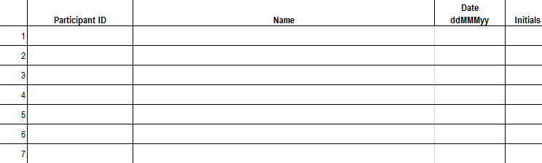
PTID/Name Linkage Log
Sample site-specific PTID/Name Linkage Log
Notes:
SCHARP will provide an electronic copy of a site-specific PTID Name Linkage Log to record each participant’s PTID and name.
Information on how to complete this log is specified in your site’s DM SOP. Again, PTIDs are assigned to a participant using the PTID Name Linkage Log only to those prospective ppts who complete IC, regardless of whether they enroll in the study. Ppts keep the same PTID even if complete multiple screening attempts. The PTID Name Linkage Log should always be stored in a double-locked area to protect ppt confidentiality and should be kept separate from ppt binders.

Slide 88
Screening CRFs
Screening Date of Visit
Demographics
Baseline Medical History Summary and Log
Concomitant Medications Summary and Log
Inclusion Exclusion Criteria
Vital Signs
Physical Exam
Anorectal Exam
Genital Exam
Local Laboratory Results
Hematology
STI Tests
HIV Test Results
Notes:
Review forms in green only for this presentation – other forms in second column will be covered in clinical and lab CRF Presentations

Slide 89
Enrollment CRFs
Randomization
Enrollment
Baseline Medical History Log (Updated)
CASI Summary and Tracking
Vital Signs
Physical Exam
Anorectal Exam
Genital Exam
Specimen Storage
Anorectal Specimen Storage
HIV Test Results
Notes:
Review forms in green only for this presentation – other forms in second column will be covered in clinical and lab and behavior CRF Presentations

Slide 90

Randomization CRF
The randomization CRF must be completed regardless if the participant screens out or enrolls.
  Located in the Enrollment folder
  “Is the participant ready to be randomized?”
    If participant screen fails, select “No”
    If enrolling, select “Yes”

Slide 91

Clinical Management
Vital Signs
Physical Exam
Anorectal Exam
Genital Exam
Product Discontinuation
Adverse Event Summary and Log
Baseline Medical History Summary and Log

Slide 92

Laboratory Related CRFs
Specimen Storage
Timed Anorectal Specimen Storage
Anorectal Specimen Storage
Local Laboratory Results
Hematology
STI Test Results
HIV Test Results
HIV Confirmatory Results

Slide 93

Follow-up Visits – Key CRFs
Follow-up Visit Summary, including Follow-up Yes/No
Additional Study Procedures
Dose Administration
Pharmacy Dispensation
Protocol Deviations Log
Product Discontinuation
Study Discontinuation
Participant Replacement

Slide 94
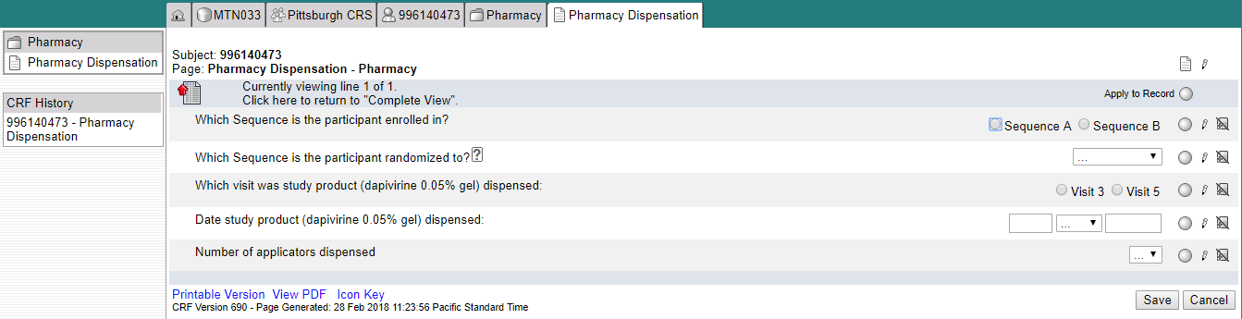
Pharmacy Dispensation
Only viewable by pharmacists
The sequence the participant is “randomized to” will be autopopulated after the form is saved
  Will serve as a check against what is entered the sequence the participant is “enrolled in”

Slide 95
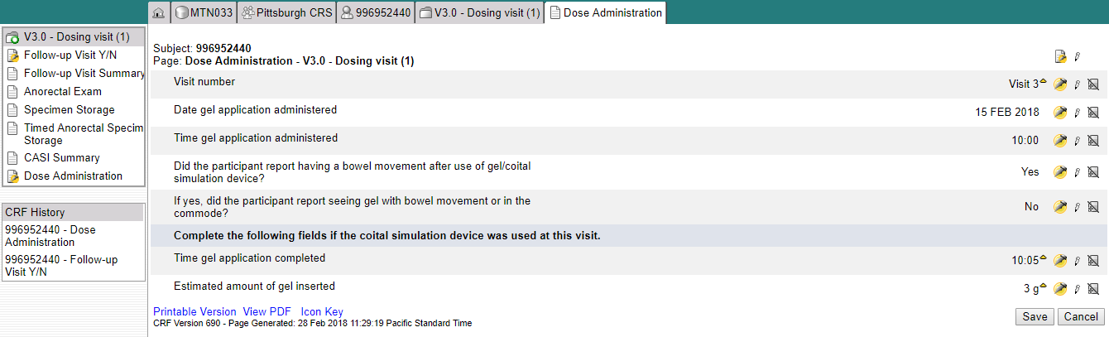
Dose Administration
Form appears in visit folders 3 and 5
Certain fields are only applicable if the coital simulation device is used.

Slide 96

Case Report Forms
eCRF Rave output available as single PDF on MTN-033 ATLAS webpage
  https://atlas.scharp.org/cpas/project/MTN/033/begin.view
  To be used as back-up (contingency) in event database cannot be accessed (e.g. temporary internet or power outage)
Vision = EDC! (NO paper CRFs)

Slide 97
MTN-033
Reports and Other Resources

Slide 98
MTN-033 Routine Study Reports
Rave Reports
  Query Detail
  Query Summary
  Page Status Comprehensive
  Productivity
Emailed Report
  LDMS Specimen Monitoring
ATLAS Reports
  Screen Out
  Enrollment
  Retention
  Visit Adherence (Procedures Completion)
  Missed Visit Summary Report
  Missed Visit Site Listings
  Data Management Quality (DMQ) Report
  Data Summary Report
Notes:
Transition to discussing reports and data quality.

Slide 99
Medidata Rave Reports
Designated site staff (Site IoR, Study Coordinator, and Data Manager) will have access to these reports
The Reporter eLearning module will automatically be added to your homepage to complete (no email is sent from iMedidata)
Should additional data team staff members need access to the these reports, please send this request to sc.medidata.acccess@scharp.org

Slide 100
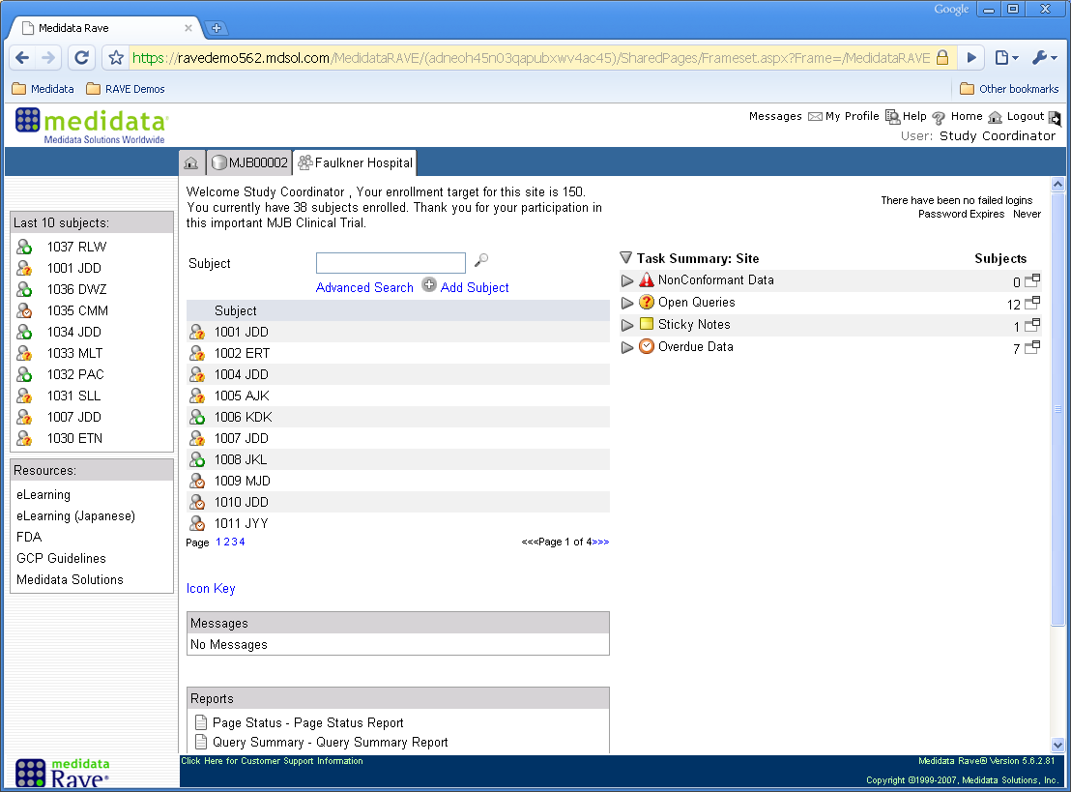
Rave Reports
Assigned Reports

Slide 101
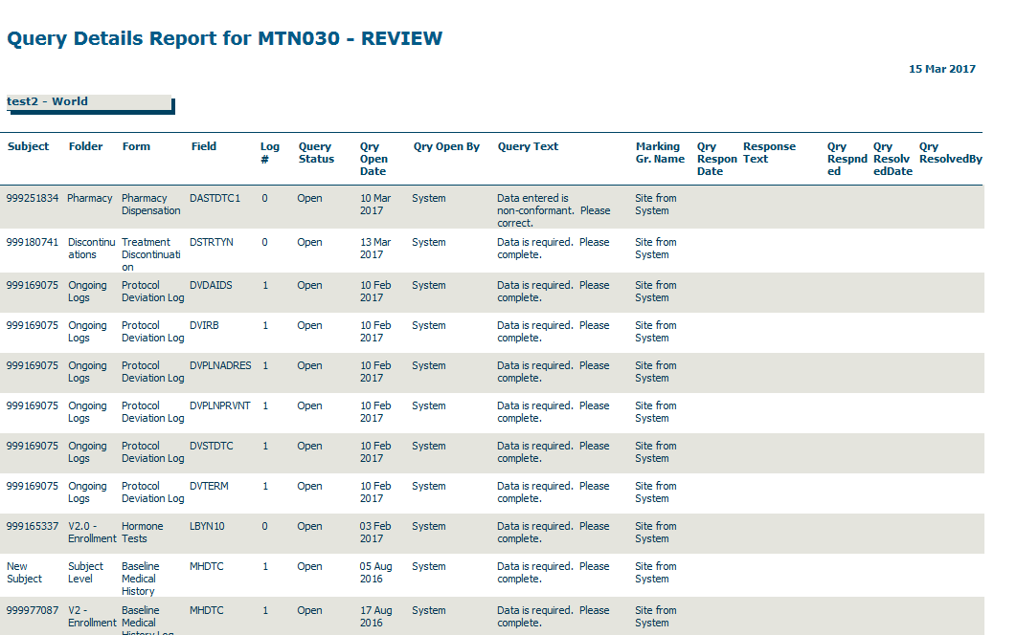
Data Metric Tools in Rave
Data queries report (by site)
Notes:
Data metrics (QC reports) can be generated with Rave and exported as PDF or excel files. QC reports can be run by site, by participant, by form, by study visit, or by a specific item on an eCRF. Reports for queries generated just by the study Clinical Data Manager or the study monitor can also be generated as well as reports by query status (open, answered, closed, cancelled) or between a specific time period.

Slide 102
SCHARP Data Reviews
SCHARP Data Managers:
Review protocol endpoint data
Review and resolve answered system queries
Place, review, and resolve manual queries based on ongoing data review (Site from DM)
SCHARP CSA:
Reviews clinical CRFs such as AE log CRFs on an ongoing basis
Places, reviews, and resolves manual queries based on ongoing clinical data review (Site from Safety)

Slide 103
PPD Monitoring - Targeted Source Data Verification (TSDV)
DAIDS, SCHARP, & PPD to determine on which CRFs and fields to place SDV boxes within Rave.
During site monitoring visits, PPD monitors use the Task Summary on the Rave homepage to identify forms required for review.
PPD monitors use TSDV boxes to document their reviews within the study database.
PPD monitors can place manual queries for the site to review and address (Site from monitor)
Notes:
PPD monitors can place manual queries for the site to review and address by updating the item in question and or providing a response to the query by providing additional information. SCHARP can also place queries within Rave as a communication tool between SCAHRP and PPD.
Typically fields that are reviewed by the PPD monitors include inclusion exclusion criteria and primary endpoint data.

Slide 104
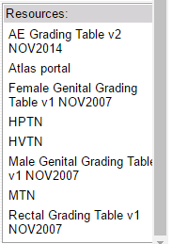
Resources Within Rave
Resource Pane: bottom left-side of home screen
  Displays a list of internet links that are standard across HVTN, HPTN, and MTN studies.
    AE Grading Table v2
    Atlas portal
    Female Genital Grading Table v1
    HPTN
    HVTN
    Male Genital Grading Table v1
    MTN
    Rectal Grading Table v1
Notes:
On the bottom left-side of your home page is a Resource Pane with links to relevant information, such as the AE Grading Table, Atlas portal, and MTN page. The Resource Pane is a core feature in Rave for SCHARP network studies. This means that some of the links will not be relevant to you. For example, if you are a MTN site, you will not use the HVTN link.

Slide 105
Resources Within Rave
iMedidata Portal: Help menu on upper right corner provides access to these functions:
  Help On This Page – Click to open Online Help for the current application page in a new tab.
  Knowledge Space Home – Click to open the top level Help page in a new tab.
  Show Me Videos – Click to open a new tab where you can view a short instructional video about iMedidata.
  Help center – Click to open a page that allows you to view documentation and helpful tips as well as to report a problem
Notes:
If you click on the Help button on the top right corner of the page, a drop down menu will appear with 4 different help topics to choose form: Help on this page, Knowledge Space Home, Show me videos, and Help Center.

Slide 106
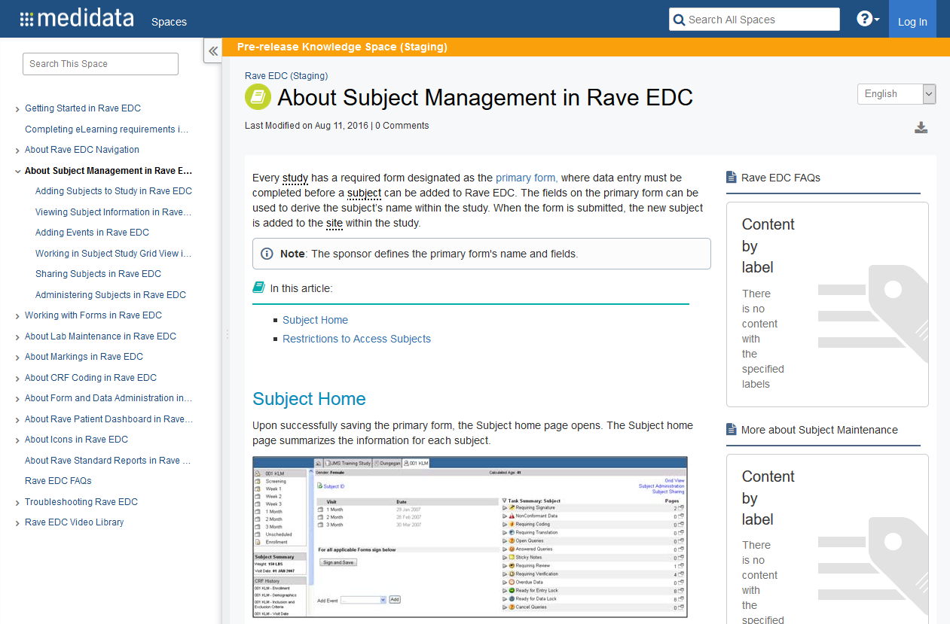
Resources: Within Rave
Once within a study, you can click on the “Help” button on any page to access information relevant to that page.
Notes:
Every page in Rave has a Help button on the top right corner. If you have a question about content on the page you are on, clicking on the help button will open a new window with help information. For example, if you click on the help button when on a participant page, the window on this slide will open. You can click on the links to the right to drill down for more information.

Slide 107
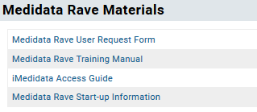
MTN-033 Resources
MTN website
  SSP
  Specimen Label Macro
  Visit Calendar Tool
MTN Atlas Portal (https://atlas.scharp.org/cpas/project/MTN/033/begin.view)
  eCRF Medidata Rave Output
  CRF Completion Guidelines (CCGs)
  Medidata Rave Materials
Notes:
Will post Medidata Rave training slides

Slide 108
Medidata Rave User Accounts
To update or remove existing user accounts, or to add new user accounts, complete Medidata Rave User Request Form with these details and email this form to sc.access.medidata@scharp.org.
Notes:
SCHARP ticketing system will track progress as we proceed with user access administration.

Slide 109
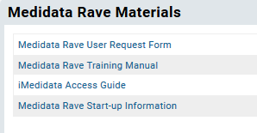
Medidata Rave User Accounts
The Medidata Rave User Request Form is available on the MTN-033 ATLAS portal under the “Medidata Rave Materials” section.
Your request typically will be completed within 3-5 business days, but please ensure that a request is submitted no later than 1 week prior to when site staff will need access to Rave to ensure ample time.

Slide 110
Participant Grid View
The Participant Grid View:
  Displays participant folders and forms in a grid format
  Provides the status of specific forms
  Allows authorized Rave users to quickly perform activities such a freeze, sign-off, verify, and sign-off on multiple forms
      E.g., Investigator role can quickly sign-off on multiple eCRFs for a given participant at the same time
Notes:
The Grid View provides an alternate display of a participant’s folders and forms in a grid format. The Grid View allows you to find and display participant visits and associated forms, including the status of specific forms. Forms without status icons have no saved data. The Grid View allows authorized Rave users such as site/PPD monitors, site investigators, and SCHARP data managers to quickly perform activities, such as, verify, freeze, sign-off, and lock on multiple forms at a time.

Slide 111
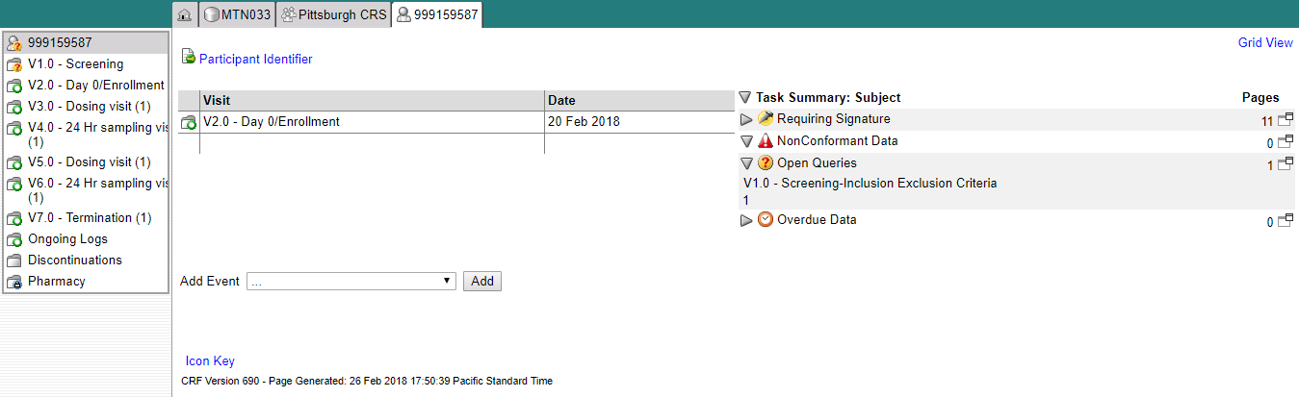
Participant Grid View
To access the participant grid view, click on “Grid View” located in the upper right corner of the participant’s main page.
Notes:
To access the participant grid view, navigate to the “Grid View” link located in the upper right hand side of each participant’s home (or calendar) page. This gives a good snapshot/overview of forms completed for ppt.

Slide 112
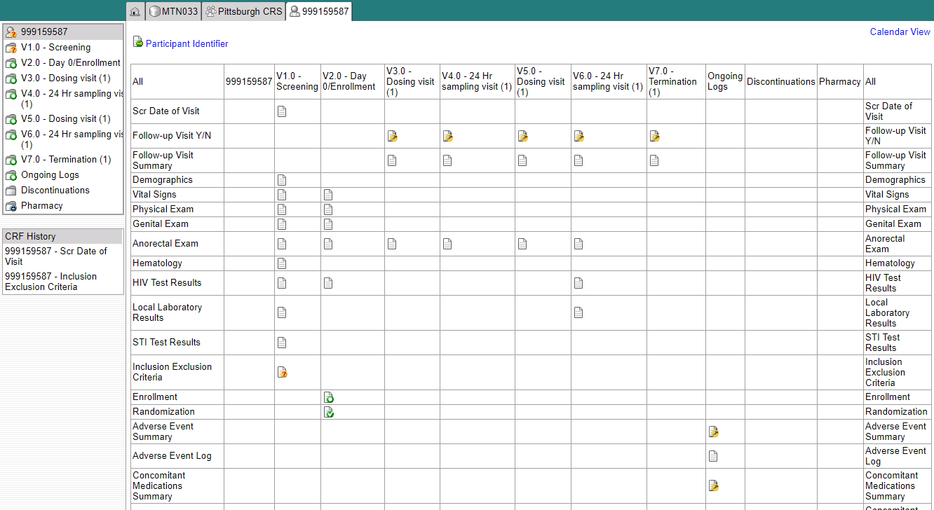
Participant Grid View
Notes:
Here you will see that the grid view allows for you to view all folders and forms for a participant. Forms that have been completed or are expected to be completed will appear with an icon. If a form or a folder is not in participant’s visit folder, the cell will appear empty. For example, forms not required at Screening are left blank.
The same status icons that we reviewed for each item within an eCRF appears within Grid View as well. These icons show whether the form is completed, is overdue, locked, has queries, and so on.
You can navigate to the page view of each form listed to view the data recorded on each form by clicking on the icon.

Slide 113
Participant Grid View – Investigator Role
Electronic form sign-off by the Site Investigator (IoR) to verify the completeness and accuracy of the study data should occur after all queries have been resolved on the form and prior to database lock as the study approaches close out and completion.
To maximize efficiency, please hold off on providing Investigator sign-off for a participant casebook until instructed by SCHARP CDM(s).
  Single sign-off per participant once participant terminates from study
  Site Investigator sign off of a form should not be completed until after data review by a PPD monitor or by a SCHARP Data Manager and all queries are resolved.
Notes:
Site Investigators of Record (IoR) will electronically sign a form within Rave to verify the completeness and accurateness of the study data once data has been entered for that form and all queries associated with the form have been resolved. Site investigators can use the participant grid view to sign-off on multiple forms at a time. Each completed form within Rave must be electronically signed by the site investigator verifying completeness and accurateness of the study data. While investigators have the option to sign off on eCRFs at any point during the study once all queries have been resolved and prior to database lock, we recommend that form sign off towards the end of the study and during the study close out period for greatest efficiency. If forms are updated after an initial sign-off by the IoR, the eSignature is broken and the investigator will need to complete a second sign off of the form. The study SCHARP Clinical Data Manager will provide instruction on the optimal time for IoRs to provide eSignatures during study close out to avoid the need for multiple sign-offs for a given CRF.

